Slide 1

Integrated Mental Health Strategic Pathway for Nottingham and Nottinghamshire & Tackling Loneliness

Slide 2
Ruthe Sawyer
Project Manager – Integrated Mental
Health Commissioning

Slide 3
Integrated Mental Health Commissioning Strategic Plan
Integrated Mental Health Pathway Strategic Plan 2024/25-2026/27 published July 31st 2024
System-wide working across Nottingham and Nottinghamshire
Scope covers Adult Mental Health pathway, inclusive of Learning Disability and Autism pathway
Decision was made as a system to look at strategic plan across pathway rather than inpatient focus in isolation
Working towards delivery of the plan over next 3 years

Slide 4

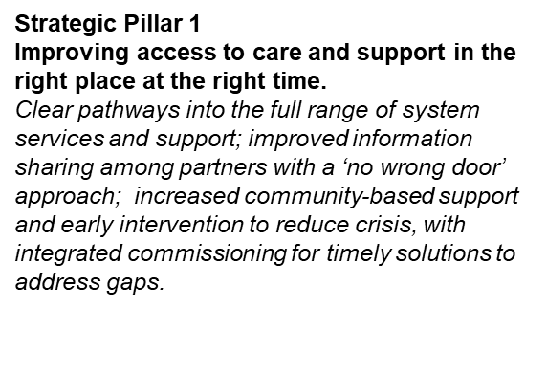
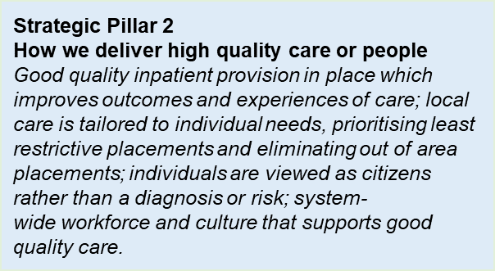
Strategic pillars
System partners have developed key areas of focus within these pillars that will enable the system to deliver on the vision for the integrated mental health pathway
Strategic Pillar 3
Timely discharge to the place people call home
Increased housing and support to enable people to live in the place they call home; identifying needs early at admission to support discharge (housing and wider support); putting people at the heart of their discharge planning; improved system data to inform planning and commissioning to meet local need.

Slide 5
The delivery phase so far…..
Integrated Mental Health Oversight Group
Coproduction Group – Partners in Mind began April 2024
Outcomes Framework agreed
Pathway Mapping Workshop
Integrated Commissioning roadmap
Improving Access in the Community Subgroup – No Wrong Door & Referral Pathway

Slide 6
The Experience of Loneliness
“Referral pathways need to be easier for people to navigate to avoid making people feel alone”
“Consider how loneliness affects mental health and understand that clinical skills are not necessary to connect with someone”
“If people are isolated, self-management can reinforce loneliness and negatively impact their mental health”
Drop-in cafes for connection, conversation, and reducing loneliness and isolation were suggested.
Need for advocacy – for people without a strong network of personal support

Slide 7
Measuring the Outcomes differently
People do not need to repeat their story continuously
People can access information about support available in their local area.
People can access a range of support available in their local community to meet their needs
People have access to care and support at the right time
People on waiting lists are not forgotten about and receive clear, regular updates
People are active citizens and connected in their local area
People are involved in decisions about their care and support
Increased coproduction and engagement in services
There are equitable and culturally appropriate services that meet a range of needs for our diverse population
‘everyone counts’ nobody is excluded, discriminated against or left behind.

Slide 8

Referral pathway review
Please complete the referral pathway review form by December 3rd 2024. It takes 5 minutes and can improve access into services – improving experience and reducing barriers

Slide 9
What Next?
Collecting our baseline data for January 2025
No Wrong Door and referral routes plan to be developed by our “improving access” subgroup
Developing our place based working
Growing the coproduction group – Partners in Mind
Looking at integrated commissioning opportunities as part of the pathway
Connecting the dots with our system partners – Severe Multiple Disadvantage, Health Inequalities, Children and Young People
Further system-wide workshops and workstreams

Slide 10
Ruthe Sawyer
Ruthe.sawyer@nhs.net

