Slide 1
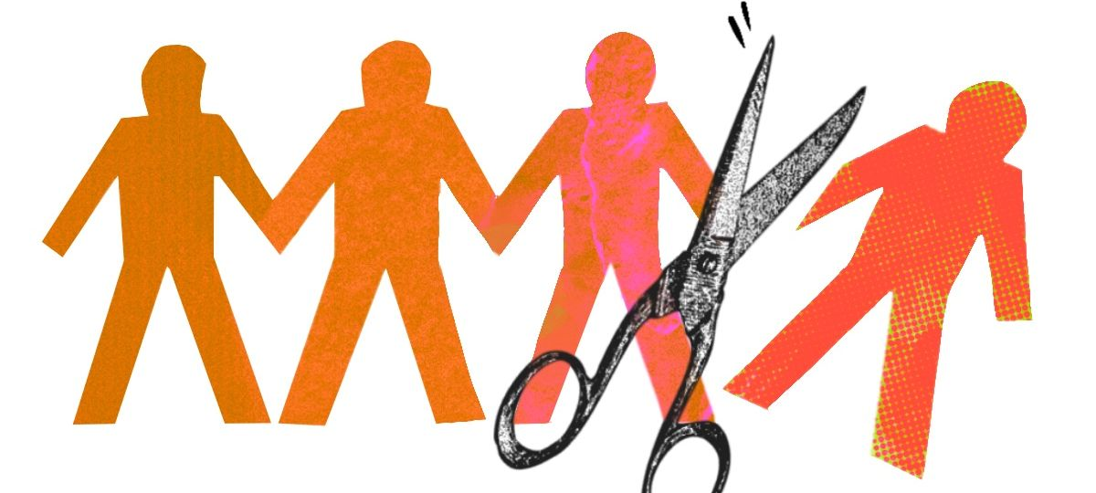
Beyond at “risk groups:” Loneliness inequalities and social exclusion
Manuela Barreto
Tackling Loneliness, 12th November 2024
Notes:
Work on loneliness frequently refers to groups “at risk of loneliness” or even to groups “vulnerable to loneliness”. While this is sometimes done to draw attention to the particularly dire situation of individuals who belong to some social groups, it is seldom taken further to an in-depth exploration of what causes this situation, or how it can be addressed. Moreover, such expressions suggest there is something about the group that causes their loneliness—which makes them especially vulnerable or at risk—which contributes both to stigmatizing these groups and to stigmatizing loneliness. Instead, in this presentation I will outline the existence of loneliness inequalities and argue that this is caused not by factors inherent to specific social groups but by social exclusion processes operating between individuals and within social systems.

Slide 2
Loneliness inequalities
Dominant narrative: Individual deficits that require individual solutions
But loneliness is socially patterned: Unequally distributed across social groups
Prevalence highest in minoritised and devalued social groups

Slide 3
Migrants
Gap migrant/non-migrant largest with larger difference from host society: culture, age of migration, migrant generation
I was feeling alienated. My loneliness was a painful and disturbing realisation of being unaccepted and unloved, of being alone and having no other choice…
Participant in a study with migrants living in London (Christodoulou, 2015)

Slide 4
Racial and ethnic minorities
Gaps at all ages, with intersections with older age, illness, and migration status
I experienced racism a lot… people posted abusive messages through the door, I felt very unwelcome and that was why I was so lonely and depressed.
African woman in her 50s in British Red Cross (2019)

Slide 5
Gender
Usually: men vs. women
Depends on how it is asked: Direct vs. Indirect questions
Assumed men face more stigma, but this is not consistently evidenced

Slide 6
Sexual and gender minorities
Consistent gaps: And more so for bisexual and asexual individuals and those still exploring sexual or gender identity
I have a group of friends, I came out to them as a lesbian about a year ago but ever since then, everything’s changed if I’m being honest.
14-year-old participant in Verity et al. (2022)

Slide 7
Mental health status
Bidirectional association/cycle, but evidence less clear for disorders other than depression and anxiety
When I suffered from anorexia, it fed into so many areas of my life. It was all consuming. One of those areas was loneliness. (…) Going out with friends always involved meals out or drinks and I was too scared.
Michelle in Mumford (2016)

Slide 8
Disability and chronic illness
Consistent gaps: Larger in older age, ethnic minorities, and those living in more deprived areas
I was gradually becoming more and more aware of my loneliness and began to long for a friend. All my classmates had at least one and most had several. I would spend hours at night awake in bed looking up at the ceiling and imagining what it might be like to be friends with somebody.
Unnamed autistic participant in Tammet (2006)

Slide 9
Poverty and unemployment
Unemployment: Consistent gap, more pronounced between 30-34 and 50-59.
SES: Consistent, irrespective of whether determined objectively or subjectively, or at individual, family, or neighbourhood levels.

Slide 10
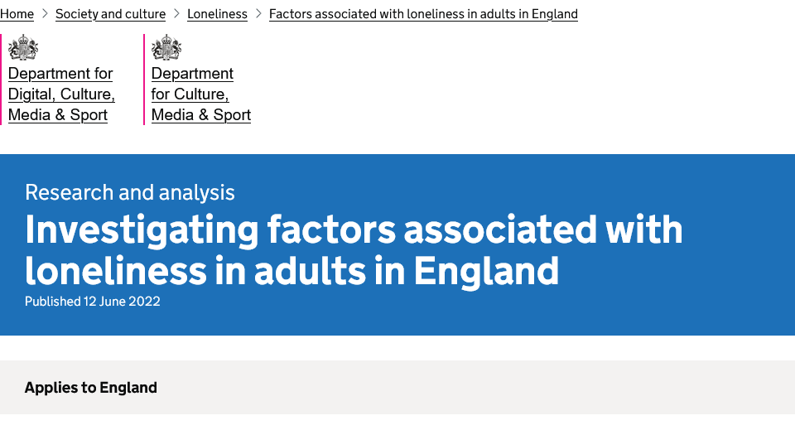
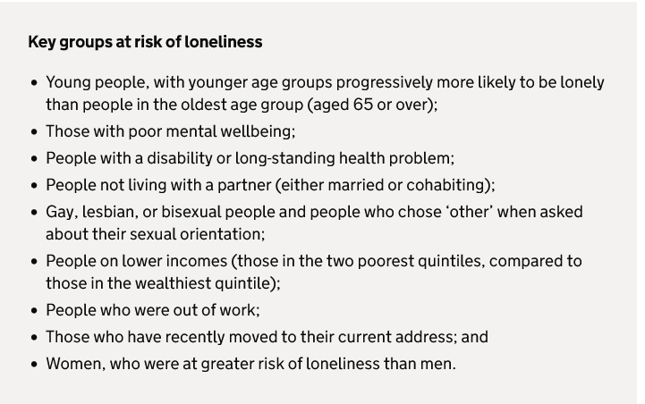
“At risk”/ “vulnerable” groups:
Political agenda for the prioritisation of preventive and corrective efforts

Slide 11
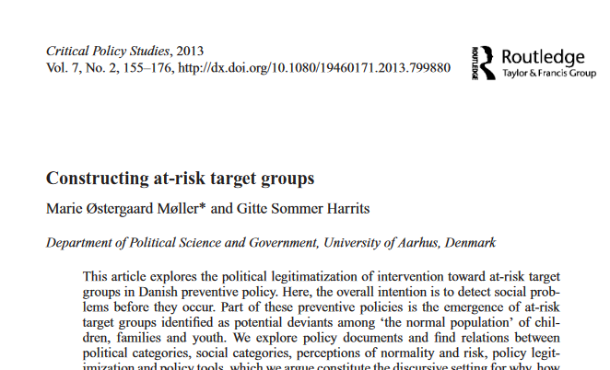
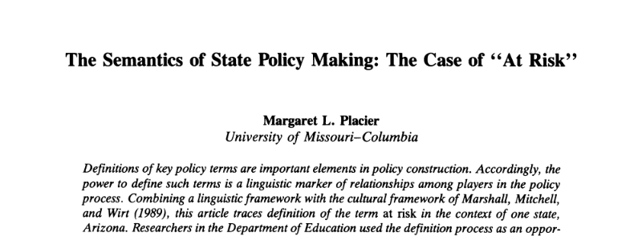
“At risk” / “vulnerable” groups?
Notes:
Various scholars from different disciplines and fields have pointed to the pitfalls involved in this language including in public health campaigns. It is not just a problem of language, though, because as we begin to understand why this language is problematic we might find that our very understanding of the problem—loneliness—is mis-guided by this language.

Slide 12
“At risk” / “vulnerable” groups?
Deterministic: Group membership/identity → loneliness
Something about the group or identity that makes one lonely
Stigmatizing:
The social construction of normality and deviance
Deficit: Something missing
“Othering:” separation between the healthy/normal and the sick/deviant
Blame: From “risk groups” to “risky behaviour”

Slide 13
“At risk” / “vulnerable” groups?
Patronizing: Politics of “helping” and legitimization of power differentials
Creation of new target groups that are seen as deviant, incapable of taking care of themselves, and requiring “extra effort” in health and social care
Whole groups seen as “at risk of developing special needs”
Unhelpful:
Identities largely unmodifiable—justifies inertia
Effective preventive and corrective efforts directed to factors that do not address disparities

Slide 14
Alternative approach
Understanding how these disparities emerge so as to disrupt marginalization
Understanding the role of contextual/structural—and modifiable—factors
Identifying assets within marginalized communities
Notes:
First two = understanding mechanism and modifiable drivers leading to better interventions
Third = empowering target groups to identify their own needs and solutions

Slide 15
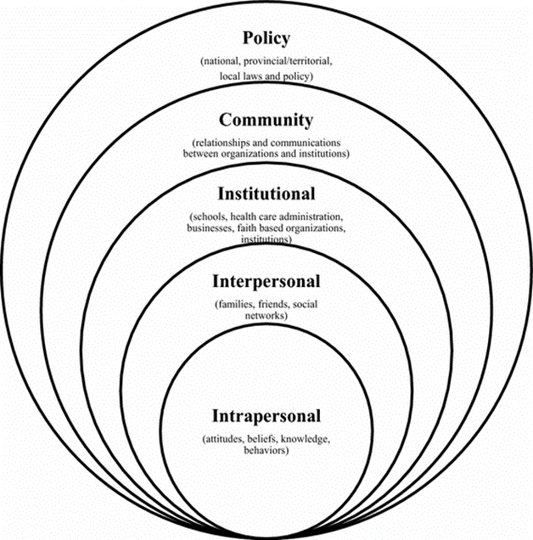
Mechanisms
The socio-ecology of loneliness
Potential for exclusion at all levels

Slide 16
Interpersonal
Relationship between group and loneliness is indirect
Not inevitable
Mediated by interpersonal exclusion processes that can be addressed
Marginalized group membership
Interpersonal exclusion
Loneliness
Notes:
Bullying, harassment, insults, hostility, undermining behaviour

Slide 17
Interpersonal
Relationship between group and loneliness is indirect
Not inevitable
Mediated by interpersonal exclusion processes that can be addressed
Physical health
Psychological wellbeing
Financial security
Marginalized group membership
Interpersonal exclusion
Loneliness
Notes:
First two = understanding mechanism and modifiable drivers leading to better interventions
Third = empowering target groups to identify their own needs and solutions

Slide 18
Interpersonal
Relationship between group and loneliness is indirect
Not inevitable
Mediated by interpersonal exclusion processes that can be addressed
Physical health
Psychological wellbeing
Financial security
Opportunity to socialise
Motivation to socialise
Relationship quality
Marginalized group membership
Interpersonal exclusion
Loneliness
Notes:
First two = understanding mechanism and modifiable drivers leading to better interventions
Third = empowering target groups to identify their own needs and solutions

Slide 19
Structural
Cultural hegemony
Exclusive Communities
Discriminatory policies
Deprived neighbourhoods
Notes:
First two = understanding mechanism and modifiable drivers leading to better interventions
Third = empowering target groups to identify their own needs and solutions

Slide 20
Structural
Norms regarding what is appropriate in social interactions determined by the dominant group
Devaluation and exclusion of other ways of being social
Cultural minorities, autistic, deaf, blind individuals
Assimilate or withdraw
Cultural hegemony
Notes:
First two = understanding mechanism and modifiable drivers leading to better interventions
Third = empowering target groups to identify their own needs and solutions

Slide 21
Structural
High levels of prejudice in the community exacerbate loneliness.
The stigma associated with loneliness perpetuates loneliness among those experiencing it.
More diverse environments are associated with less loneliness among both minority and majority populations (although changes in diversity can be initially challenging for social cohesion).
Living in environments where one’s own minority group is well represented decreases loneliness.
High neighborhood cohesion can reduce loneliness, unless it is built around common characteristics that exclude some.
But: Members of marginalized social groups, especially low SES, often not able to harness local opportunities.
Important to allow all residents to shape sense of community.
Exclusive communities
Notes:
First two = understanding mechanism and modifiable drivers leading to better interventions
Third = empowering target groups to identify their own needs and solutions

Slide 22
Structural
Discriminatory policies can have direct effects on social relationships (e.g., no access to marriage) and exacerbate effects of interpersonal discrimination.
Positive diversity climates associated with greater sense of belonging--if policies carefully implemented!
Neoliberalism increases loneliness due to encouraging competitiveness and disconnection.
Discriminatory policies
Notes:
First two = understanding mechanism and modifiable drivers leading to better interventions
Third = empowering target groups to identify their own needs and solutions

Slide 23
Structural
Community SES increases loneliness over and above individual SES.
Regular, well connected, affordable, accessible, and safe transportation allows participation in social activities.
Not simply about urban vs. rural, but good planning: Access to gathering spaces (green or not), incl third spaces reduces loneliness.
Crime rates and specifically hate crimes discourage social participation.
Deprived neighbourhoods
Notes:
First two = understanding mechanism and modifiable drivers leading to better interventions
Third = empowering target groups to identify their own needs and solutions

Slide 24
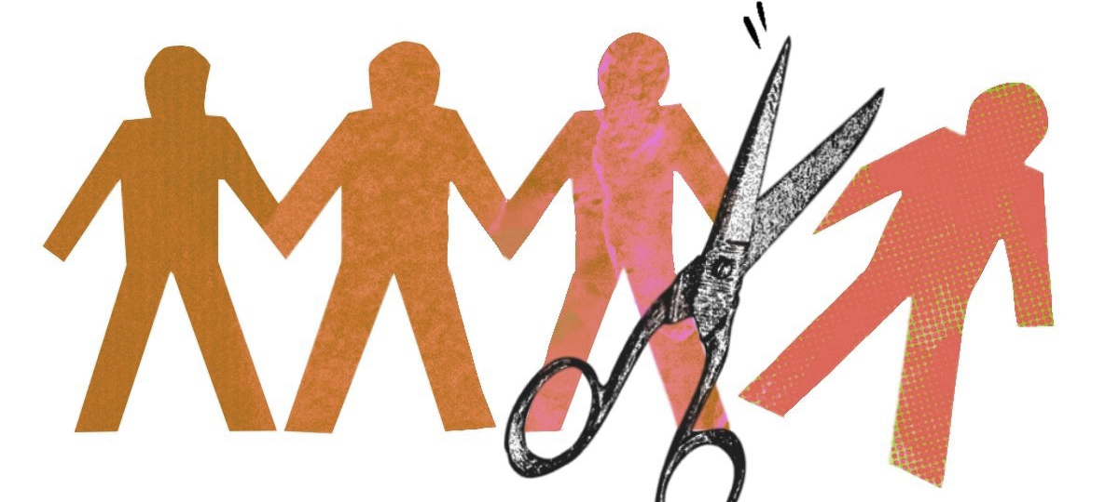
Conclusion
Need to go beyond superficial classifications of groups ‘at risk’ or ‘vulnerable’ and recognise the factors pushing them aside
These operate at multiple levels, including schools, work organizations, neighbourhoods, states, among others
These are often quite amenable to change
Involve community members in identifying their needs and solutions that work for them, but be aware that structural, institutionalised or systemic exclusion is not easily detected or described

Slide 25
Thank you
m.barreto@exeter.ac.uk

