Slide 1
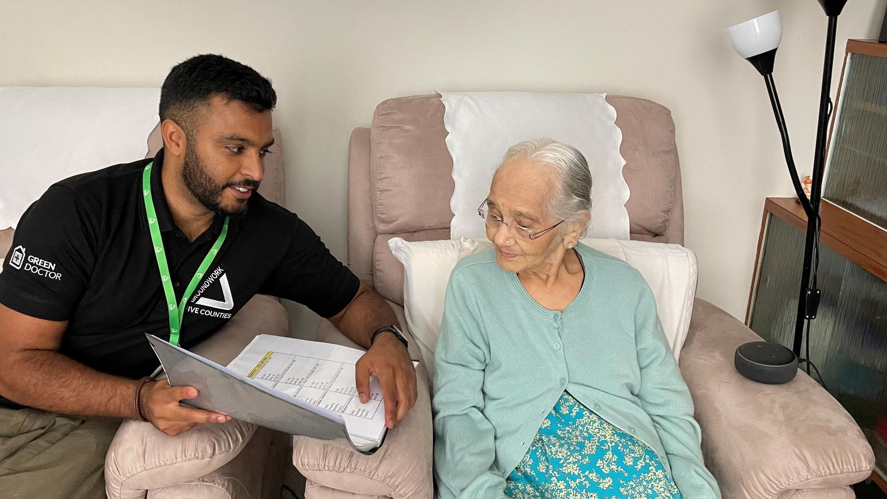
Groundwork Five Counties
GREEN DOCTOR: SAVE MONEY AND ENERGY
Introduction
Advice and support at home
Energy-saving items
In the community
Testimonials
Referrals

Slide 2
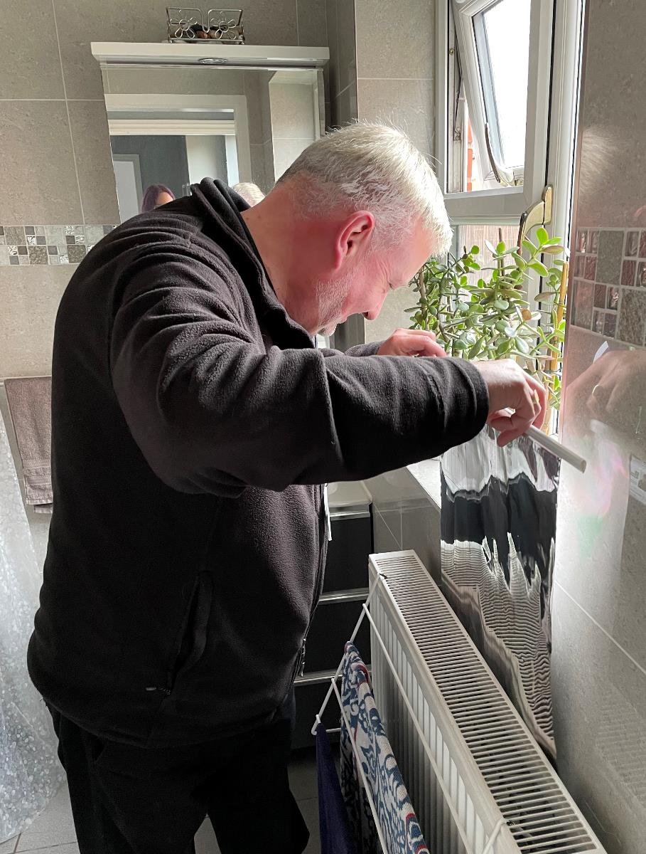
Introduction
Trained energy-efficiency experts and coaches
Advice given through home visits and community events
Home visits available around the East Midlands
Assess causes of heat loss, tackle damp or mould problems and install free energy-saving measures (LED light bulbs, draught excluders, radiator foil, etc)
Give tips and bespoke advice to save energy/water, reduce bills and encourage positive behaviour change

Slide 3
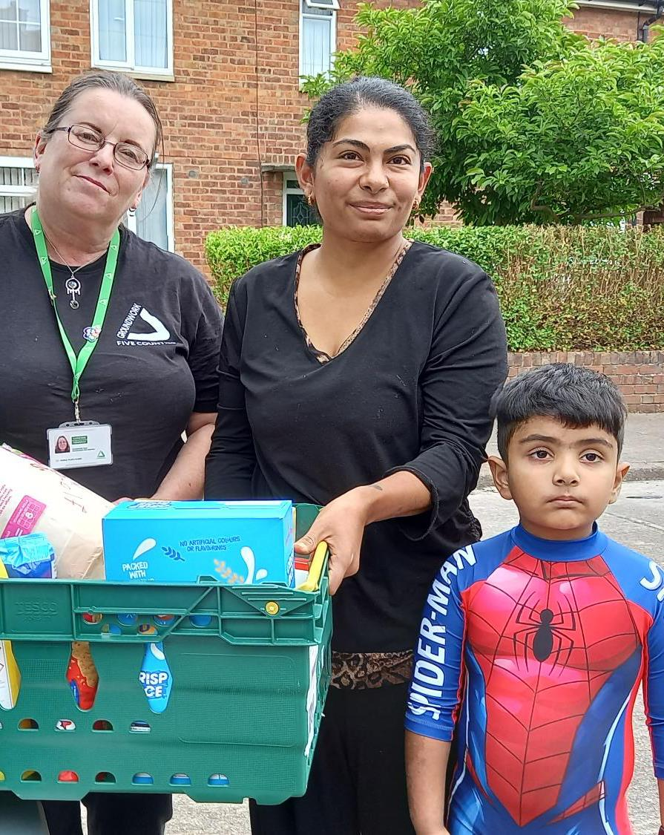
Advice and support at home
Show people how to access online bills
Show how to use their heating systems, set boilers, thermostats and radiators
Coaching people how to reduce the causes of damp and mould to keep comfortable and prevent issues
Advocating for people with energy suppliers
Supporting people to access the services they need – applying for benefits, emergency fuel or food, accessing grant funding (boilers, heating, solar panels, etc)
Showing people, not just tell them

Slide 4
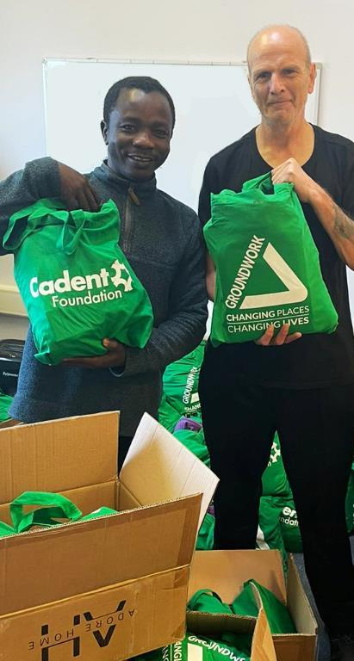
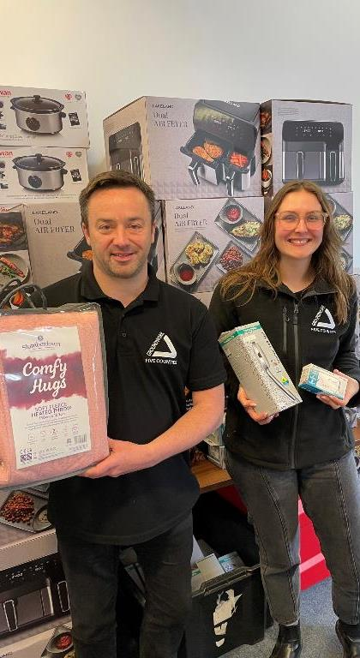
Energy-saving items
Given to those most in need, including:
Slow cookers
Air fryers
Energy saving shower heads
Carbon monoxide monitors
Heated throws
Winter Warmer packs that include thermal gloves, a hat, scarf, blanket, flask, water bottle and home thermometer.

Slide 5
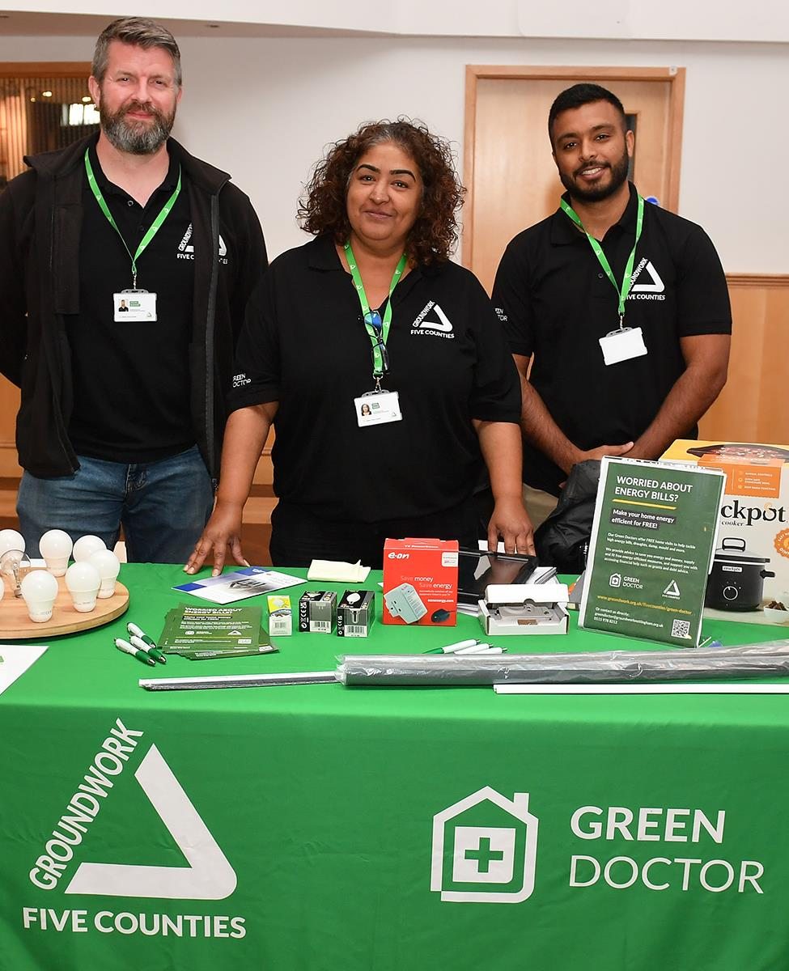
In the community
Pop-up stands at community events
Speaker slots to educate attendees around energy efficiency and easy changes to make at home or at work
Collaboration with local authorities, charities, corporate businesses and other organisations
Available to attend events around the East Midlands

Slide 6
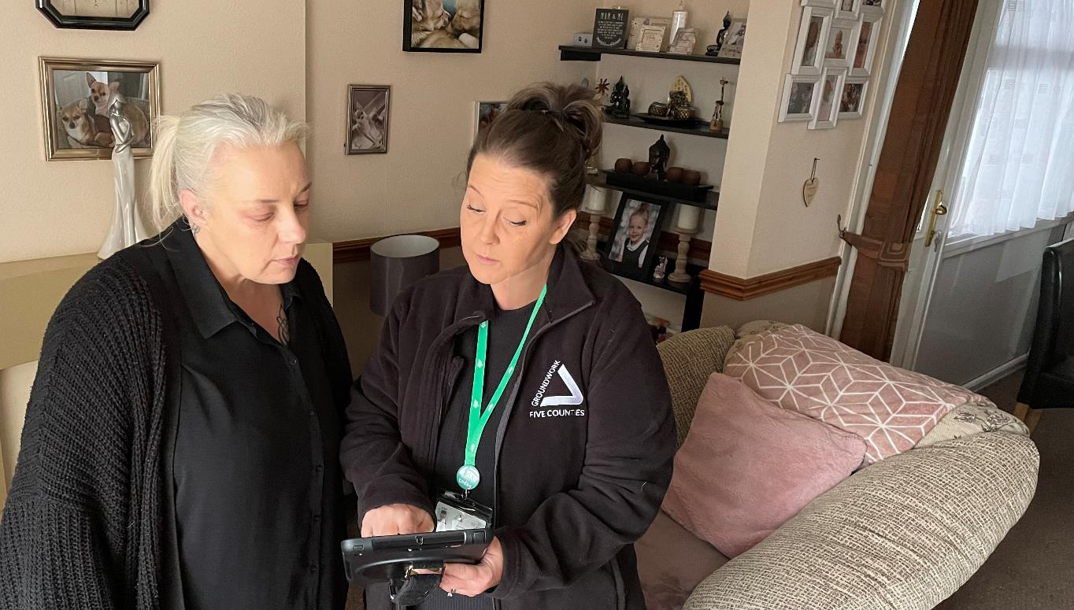
“The Green Doctor managed to get me a reduction of £300 on my water bill. I was over the moon!"
Green Doctor beneficiary

Slide 7
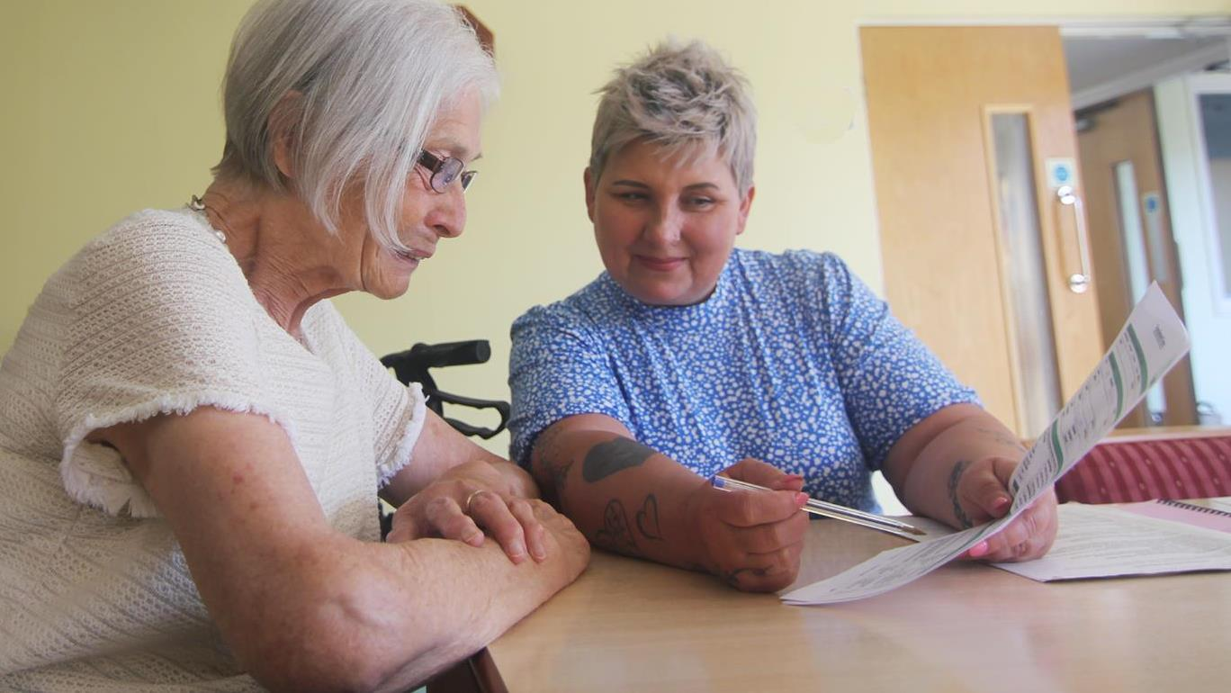
“The Green Doctor has helped me understand how to use my heating better, changed my light bulbs and gave me a heated throw. She was so kind and patient”
Green Doctor Beneficiary

Slide 8
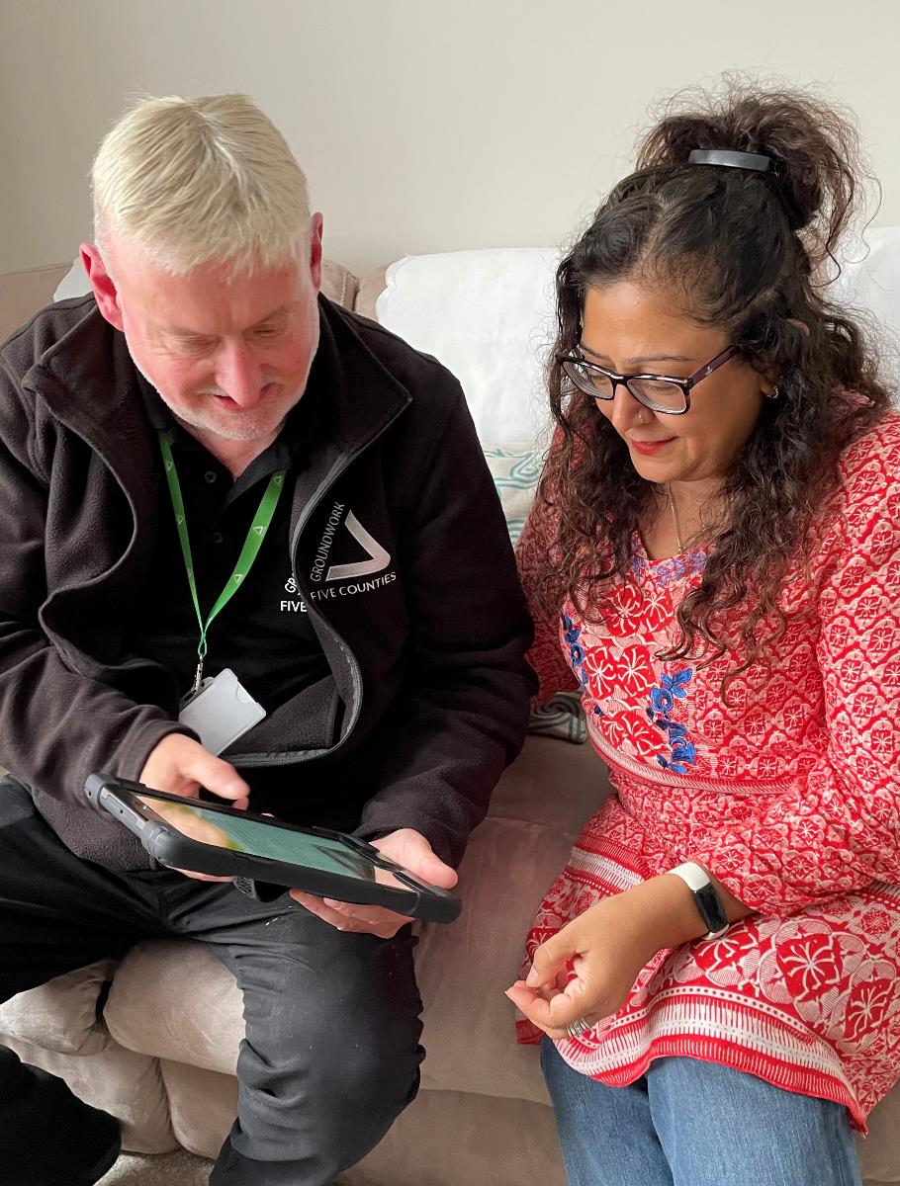
Green Doctor referrals
Via the online form found on www.groundwork.org.uk/fivecounties/green-doctor
Email greendoctor@groundworknottingham.org.uk
Call 0115 978 8212

Slide 9
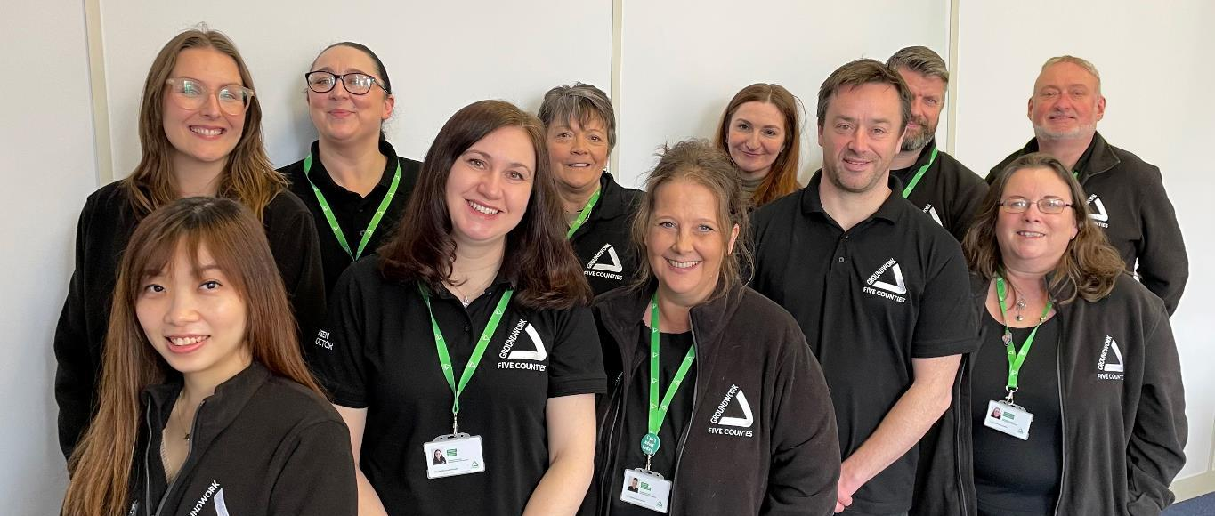
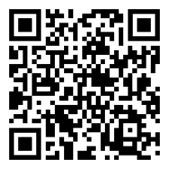
Thank you for your time!
www.groundwork.org.uk/fivecounties/green-doctor

