Slide 1



Community Grants Presentation
Chris Grocock, Head of Partnerships

Slide 2
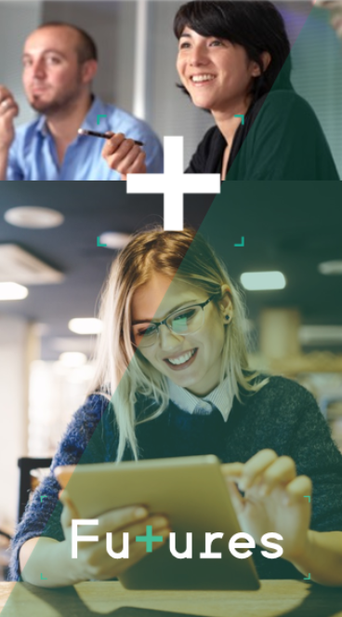
Programme Overview – Transform Your Future
One project with local features and tailored to local conditions – a pilot for devolution
Employment and Skills Support for the Economically Inactive
Direct delivery by Futures
Community Grants programme - £53,547 total pot: £10,000 - £25,000 per grant
Facilitation by CVSs to ensure local capacity and embedded delivery

Slide 3

Bassetlaw District Priorities
Engagement and Prioritisation:
Engaging on a place-based level within communities
Significantly reduce the economically inactive within Bassetlaw – especially males aged 50-64
Working with local CVSE partners to ensure holistic support to engender sustainable outcomes.
Geographical Focus :
The 60% targeted delivery will focus on key communities, including Cheapside, Sandy Lane, Manton, Wimpey Estate, Retford, Harworth & Bircotes, Tuxford, Langold, Misterton, Beckingham, and Ranskill.
Tailored Delivery:
A mix of group sessions and 1-2-1 support, bespoke to the individual’s needs. This approach will accommodate various learning styles, circumstances, and personal preferences.
An accessible programme schedule by offering sessions during evenings and weekends.
Collaboration:
Collaboration with local partners such as the Bridge Skills Hub Hub, to ensure a comprehensive and holistic support network.
Stakeholder Partnership Manager will undertake outreach efforts fostering strong linkages between different support services, we will create an environment that enhances participants' prospects for successful outcomes.

Slide 4
Community Grants Timescales
First Grant Window Open for a 6-week period – Middle of March 2024 to End of April 2024
Scoring window by grant assessment panel – End of April 2024 to Middle of May 2024
Decision by Middle of May 2024 – 1 month mobilisation
Delivery will be June 2024 – Dec 2024
Second Grant window if required – July-Sept 2024 for Oct-Mar 2024/2025 delivery (subject to change)

Slide 5
Timelines of Activity
Jan-Feb 24
Promotion of Round 1 Grants
Feb-April 24
Grant Applications window opens
April-May 24
Grant Panel
May-June 24
Intro calls with recipients
June- Dec 24
Grant Delivery
Oct 24-March 25
Grant Delivery
Sept/Oct 24
Intro Call with Recipients
September 24
Grant Panel
June-August 24
Grant Application Window Opens
March-April 24
Promotion of Round 2 Grants

Slide 6
Payment Process
Staggered payments for different milestones
25% at start once all preparation checks are done and initial contracting mtg completed​.
25% at halfway point review mtg (Time bound i.e. after 3 months if a 6-month programme).
25% once half of outputs/outcomes achieved (No earlier than halfway point i.e. if org is at 50% after a third of the project, they would need to wait for this payment at the halfway stage)
25% at completion which includes successful completion of outcomes and outputs but also all sampling, compliance checks and the receipt of an end point contract review and return of necessary case studies and evaluations)

Slide 7
Performance Management & Data Capture
Enrolment Form and Initial Assessment Form - usually done at the same time. These are signed by the customer.
Generation of an Action plan – also signed
Completion of outcomes/outputs table to maintain record of performance
Individual records to be kept (see evidence requirements, below)
Sample checks may be requested including case studies
Monthly performance reviews will take place with stakeholder partnership manager and potentially council commissioners

Slide 8
Evidence Requirements
Evidence of participants starting a course (or completing a course)
Evidence of participant accessing DWP appointment
Evidence of volunteering
Evidence of emails/wage slip/job offer
Evidence of signing up with recruitment agency
Photograph of job-searching on Indeed (risk with photographs – consent)
Evidence of a referral
Evidence of GP appointment (text confirmation) – works with ANY appointment
Evidence of attending a workshop/event/social club etc.

Slide 9
Any Questions?

