Slide 1
Report Font
This presentation uses Adobe's Report font. Present in read-only format to ensure the font displays correctly. If you have an Adobe account and wish to edit this resource using Report font, you can activate the font on your computer here: https://fonts.adobe.com/fonts/report. If you do not have an Adobe account, you can download the resource and edit using your preferred font.

Slide 2
Animations Disclaimer
We hope you find the information on our website and resources useful.
PowerPoint
This resource has been designed with animations to make it as fun and engaging as possible. To view the content in the correct formatting, please view the PowerPoint in “slide show mode.” This takes you from desktop to presentation mode. If you view the slides out of “slide show mode,” you may find that some of the text and images overlap each other and/or are difficult to read.
To enter slide show mode, go to the slide show menu tab and select either from beginning or from current slide.
Slides
This resource has been designed with animations to make it fun and engaging for children.
To ensure the content has the correct formatting, please view the presentation in “present mode.” This takes you from edit mode to presentation mode. If you view the slides out of “present mode,” you may find that some of the text and images overlap each other and/or are difficult to read.
To enter present mode, go to the “Present” tab and select “Present from beginning” or simply click “Present” to play from the current slide.
You may wish to delete this slide before beginning the presentation.

Slide 4
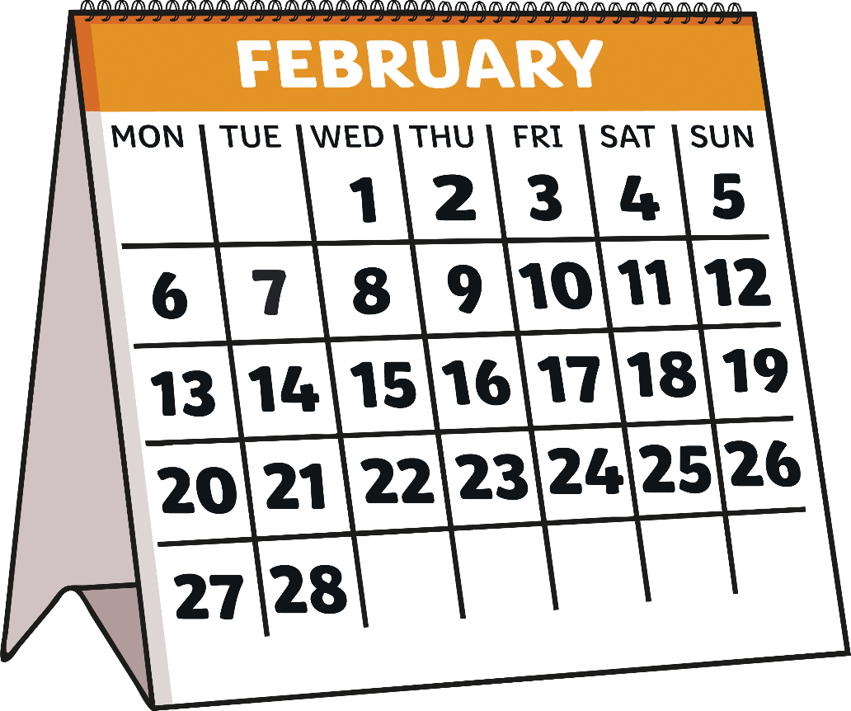
When Is Black History Month?
Each year in February, people in the United States celebrate Black History Month.

Slide 5

Turn and Talk
What do you know about Black History Month?

Slide 6
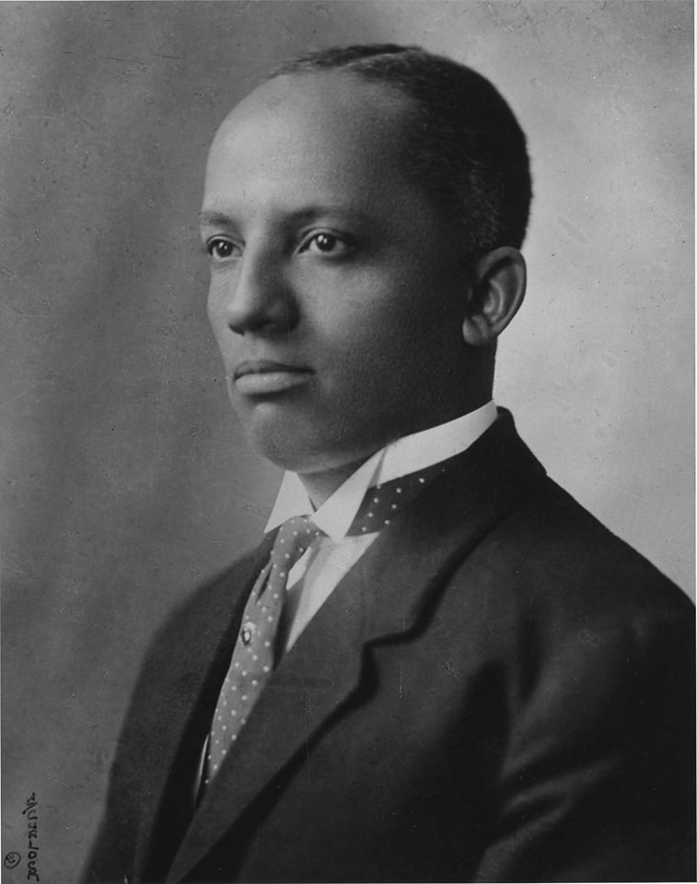
How Did Black History Month Start?
A historian named Carter G. Woodson thought that there was not enough information about the accomplishments of Black people. He helped found a group called the Association of African American Life and History in 1915.

Slide 7
How Did Black History Month Start?
This group decided to celebrate the achievements of Black Americans in our history during the second week of February.

Slide 8
Turn and Talk
Why did Carter G. Woodson think it was important to recognize the accomplishments of Black people in history?

Slide 9
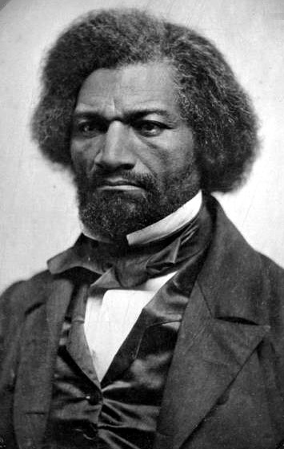
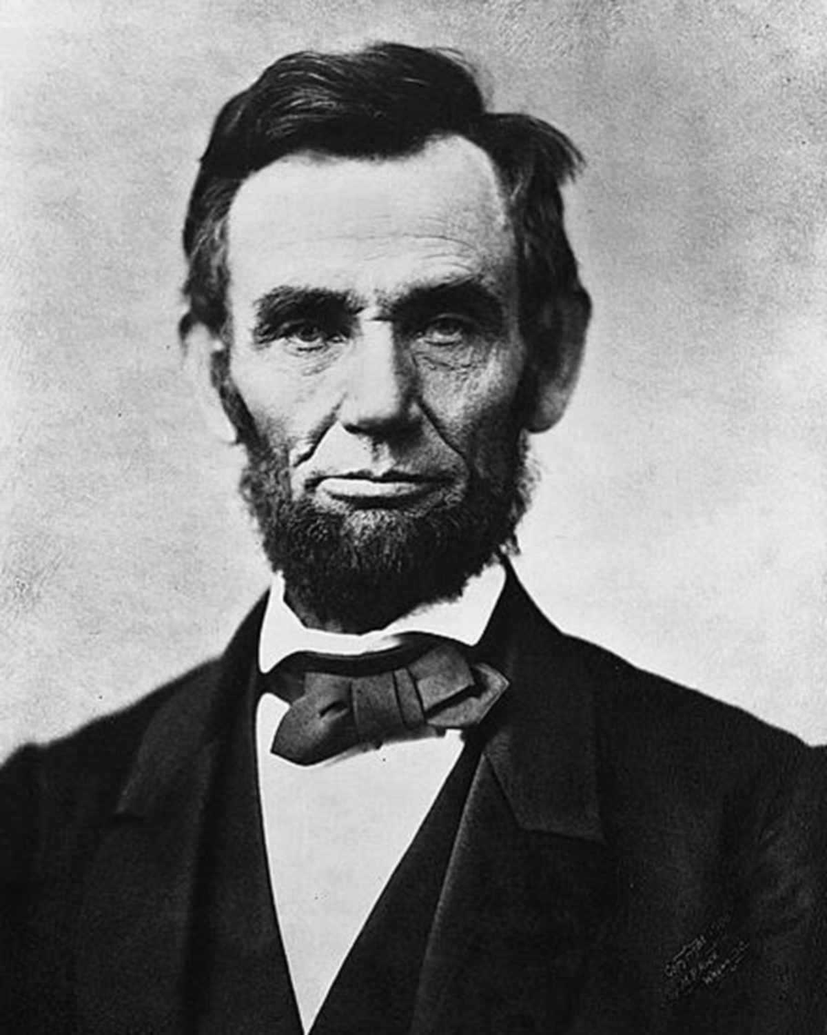
Why Is Black History Month in February?
Black History Month is in February because both Frederick Douglass and Abraham Lincoln’s birthdays are in this month.

Slide 10
Why Is Black History Month in February?
"Frederick Douglass, from an 1856 Ambrotype in the National Portrait Gallery" by Mike Licht
Frederick Douglass was an abolitionist. This means he fought to end the practice of enslaving people.

Slide 11
Why Is Black History Month in February?
Abraham Lincoln was the 16th president of the United States. He fought against enslavement of Black people during the Civil War.

Slide 12
Turn and Talk
Do you think February is a good month to celebrate Black history?
Why or why not?

Slide 13
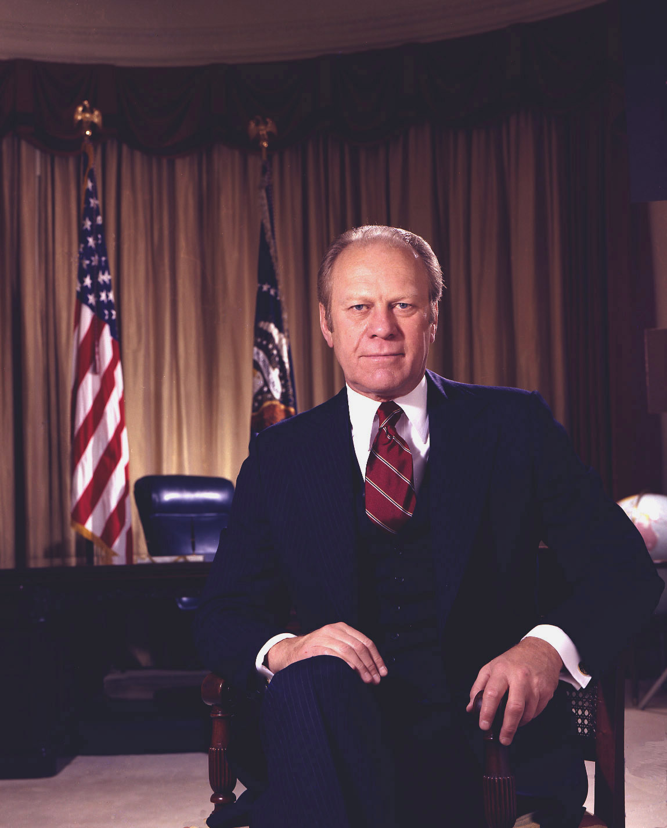
Black History Month Now
President Gerald Ford made Black History Month official in 1976. We have celebrated Black History Month in February ever since.

Slide 14
Turn and Talk
How do you want to celebrate Black History Month?
What do you hope to learn more about?

