Slide 1
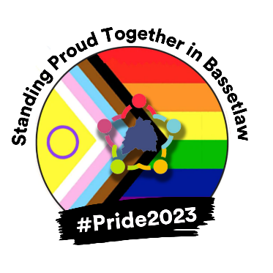
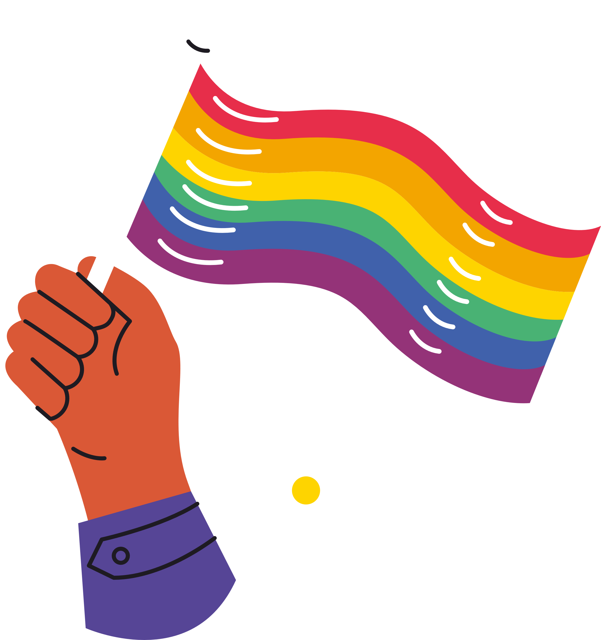
BCVS
LGBTQ+ PRIDE
QUIZ

Slide 2
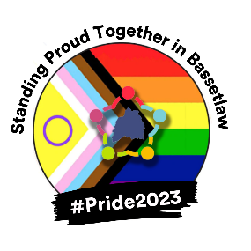
Q1. Which country became the first in the world to legalise same-sex marriage in 2001?
A) Germany
B) Netherlands
C) Canada

Slide 3
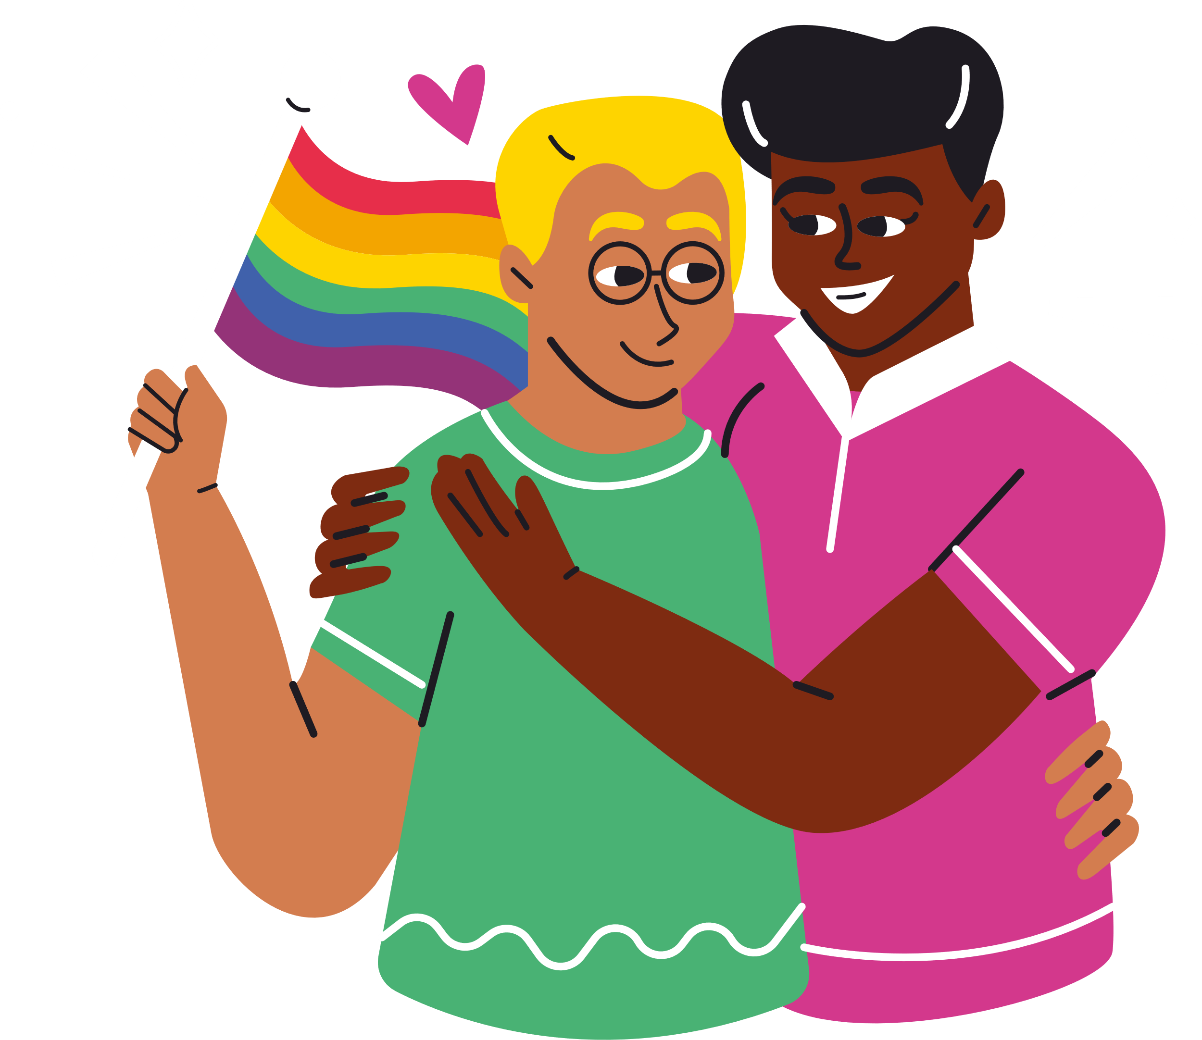
Q2. What year did same-sex marriages become legal in England and Wales?
A) 2013
B) 2014
C) 2015

Slide 4
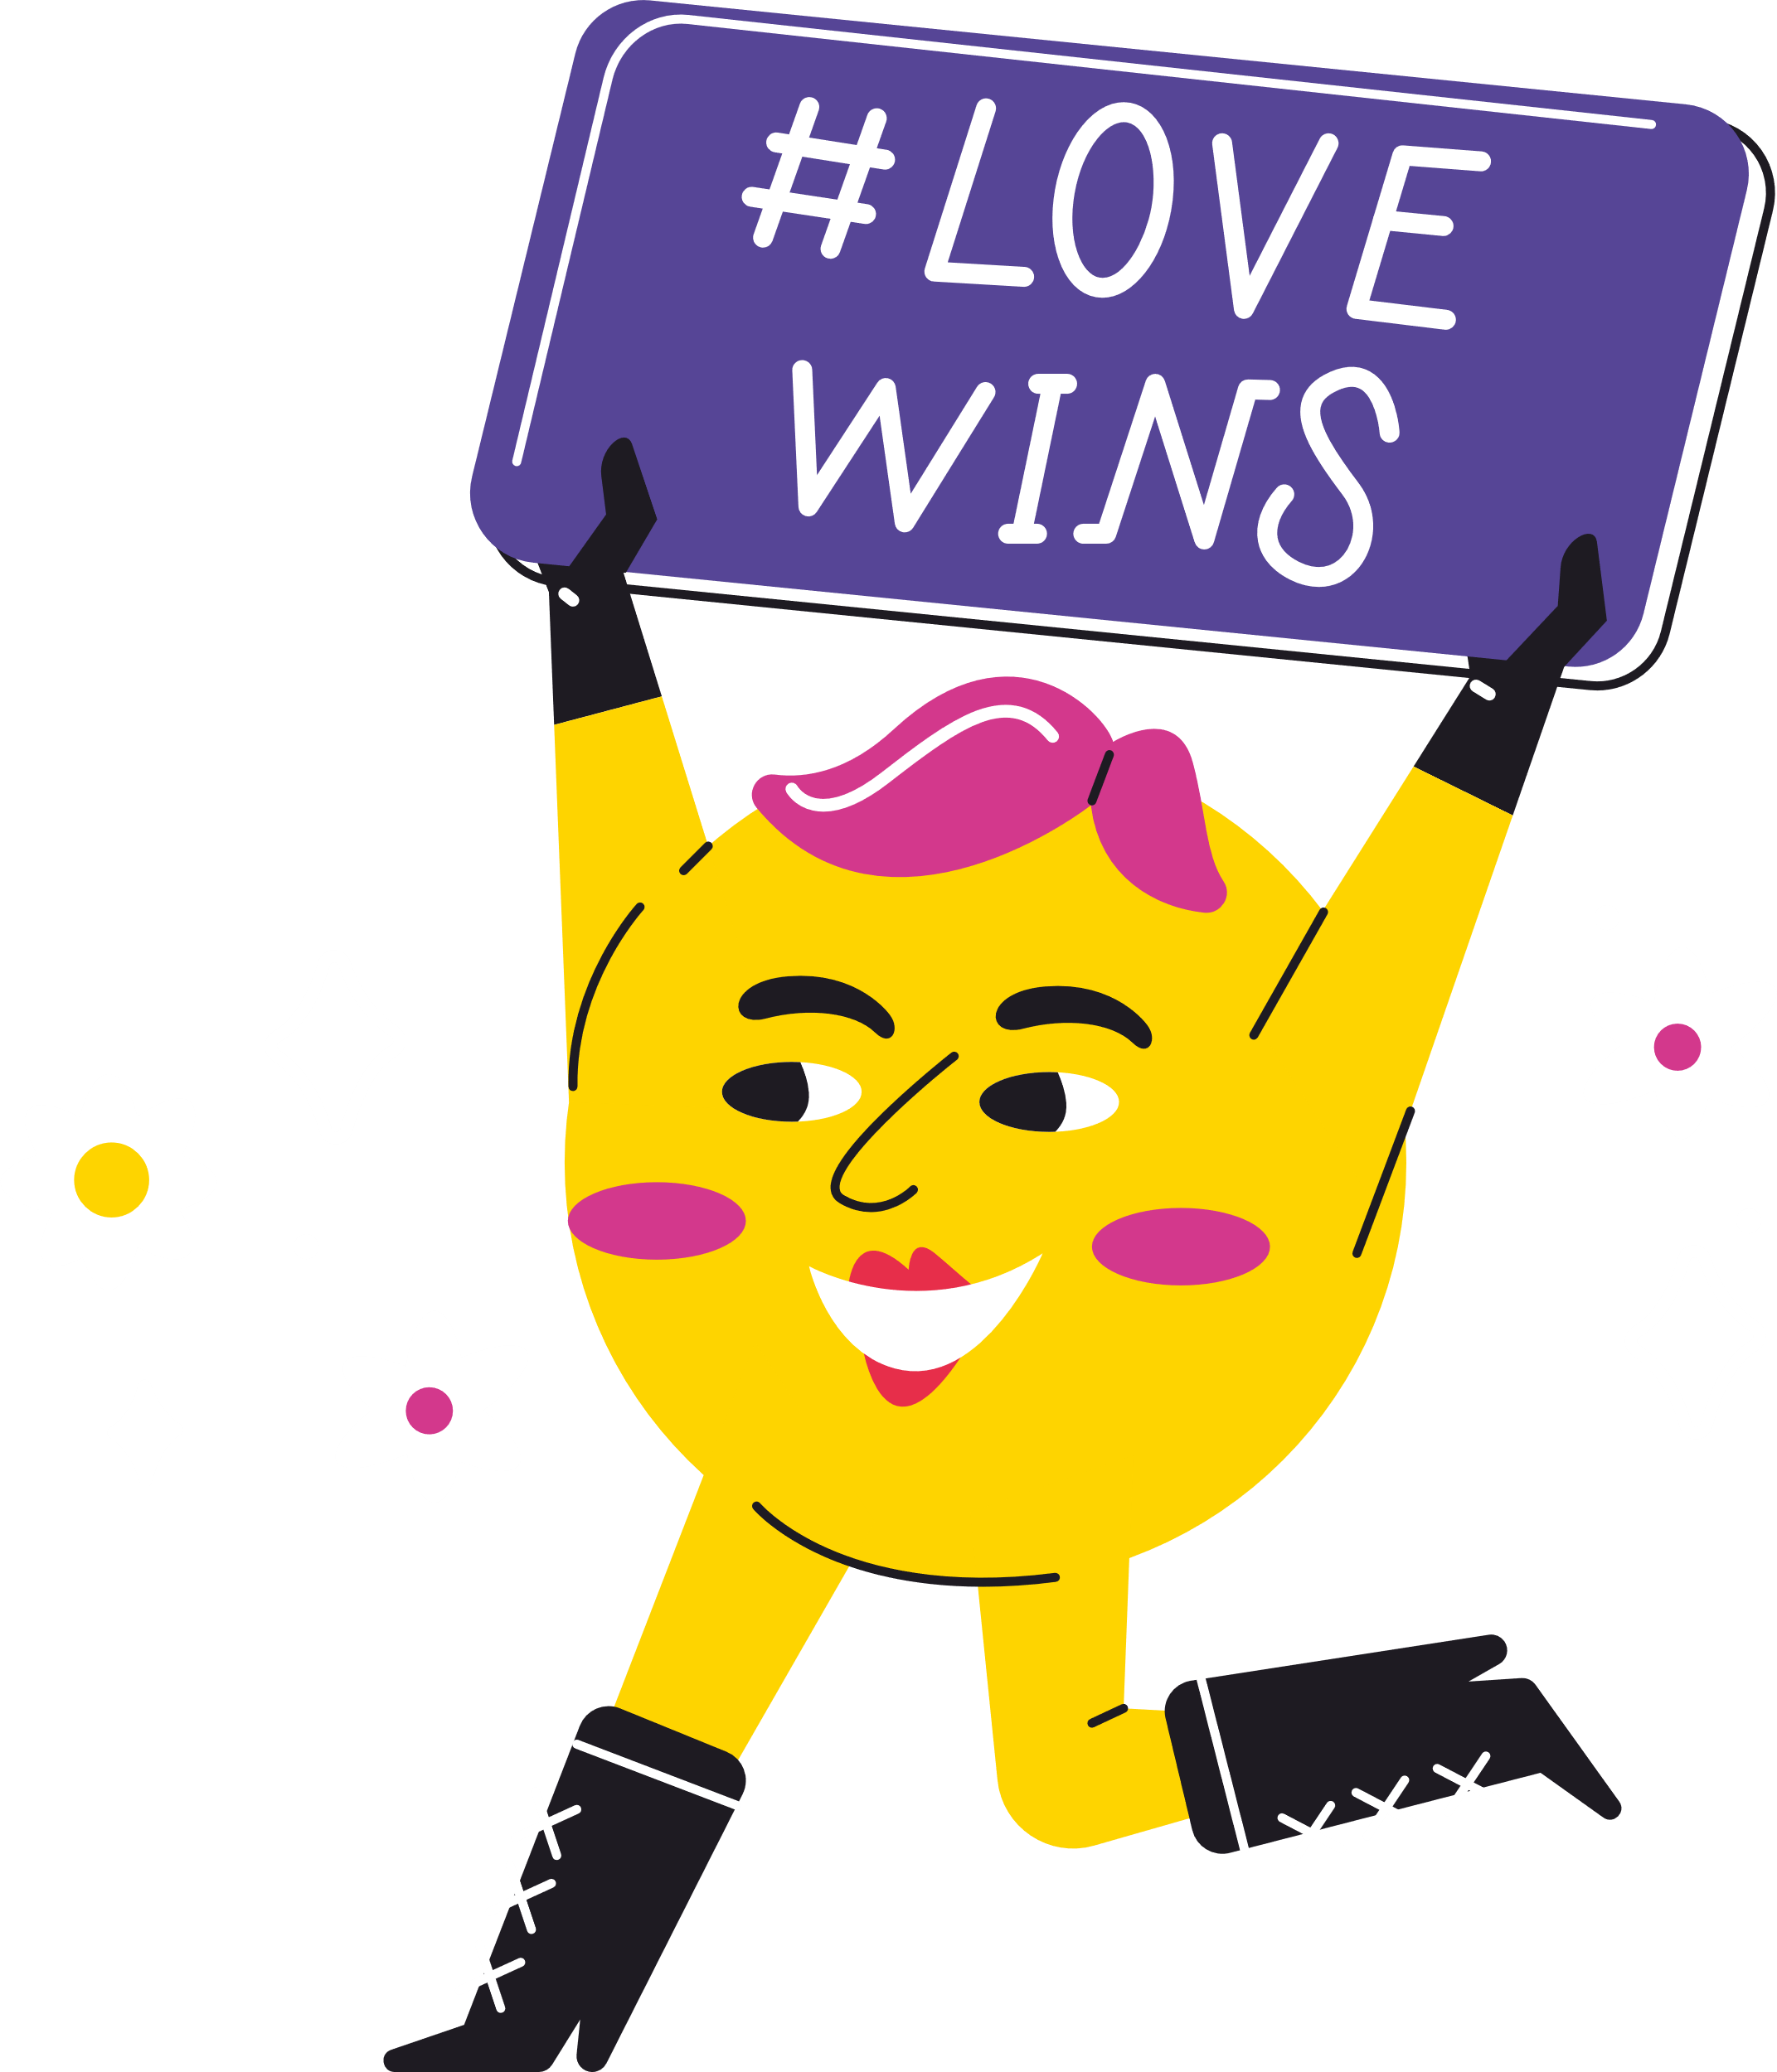
Q3. What colour is the ribbon that shows solidarity for people living with HIV/AIDS?
A) Yellow
B) Pink
C) Red

Slide 5
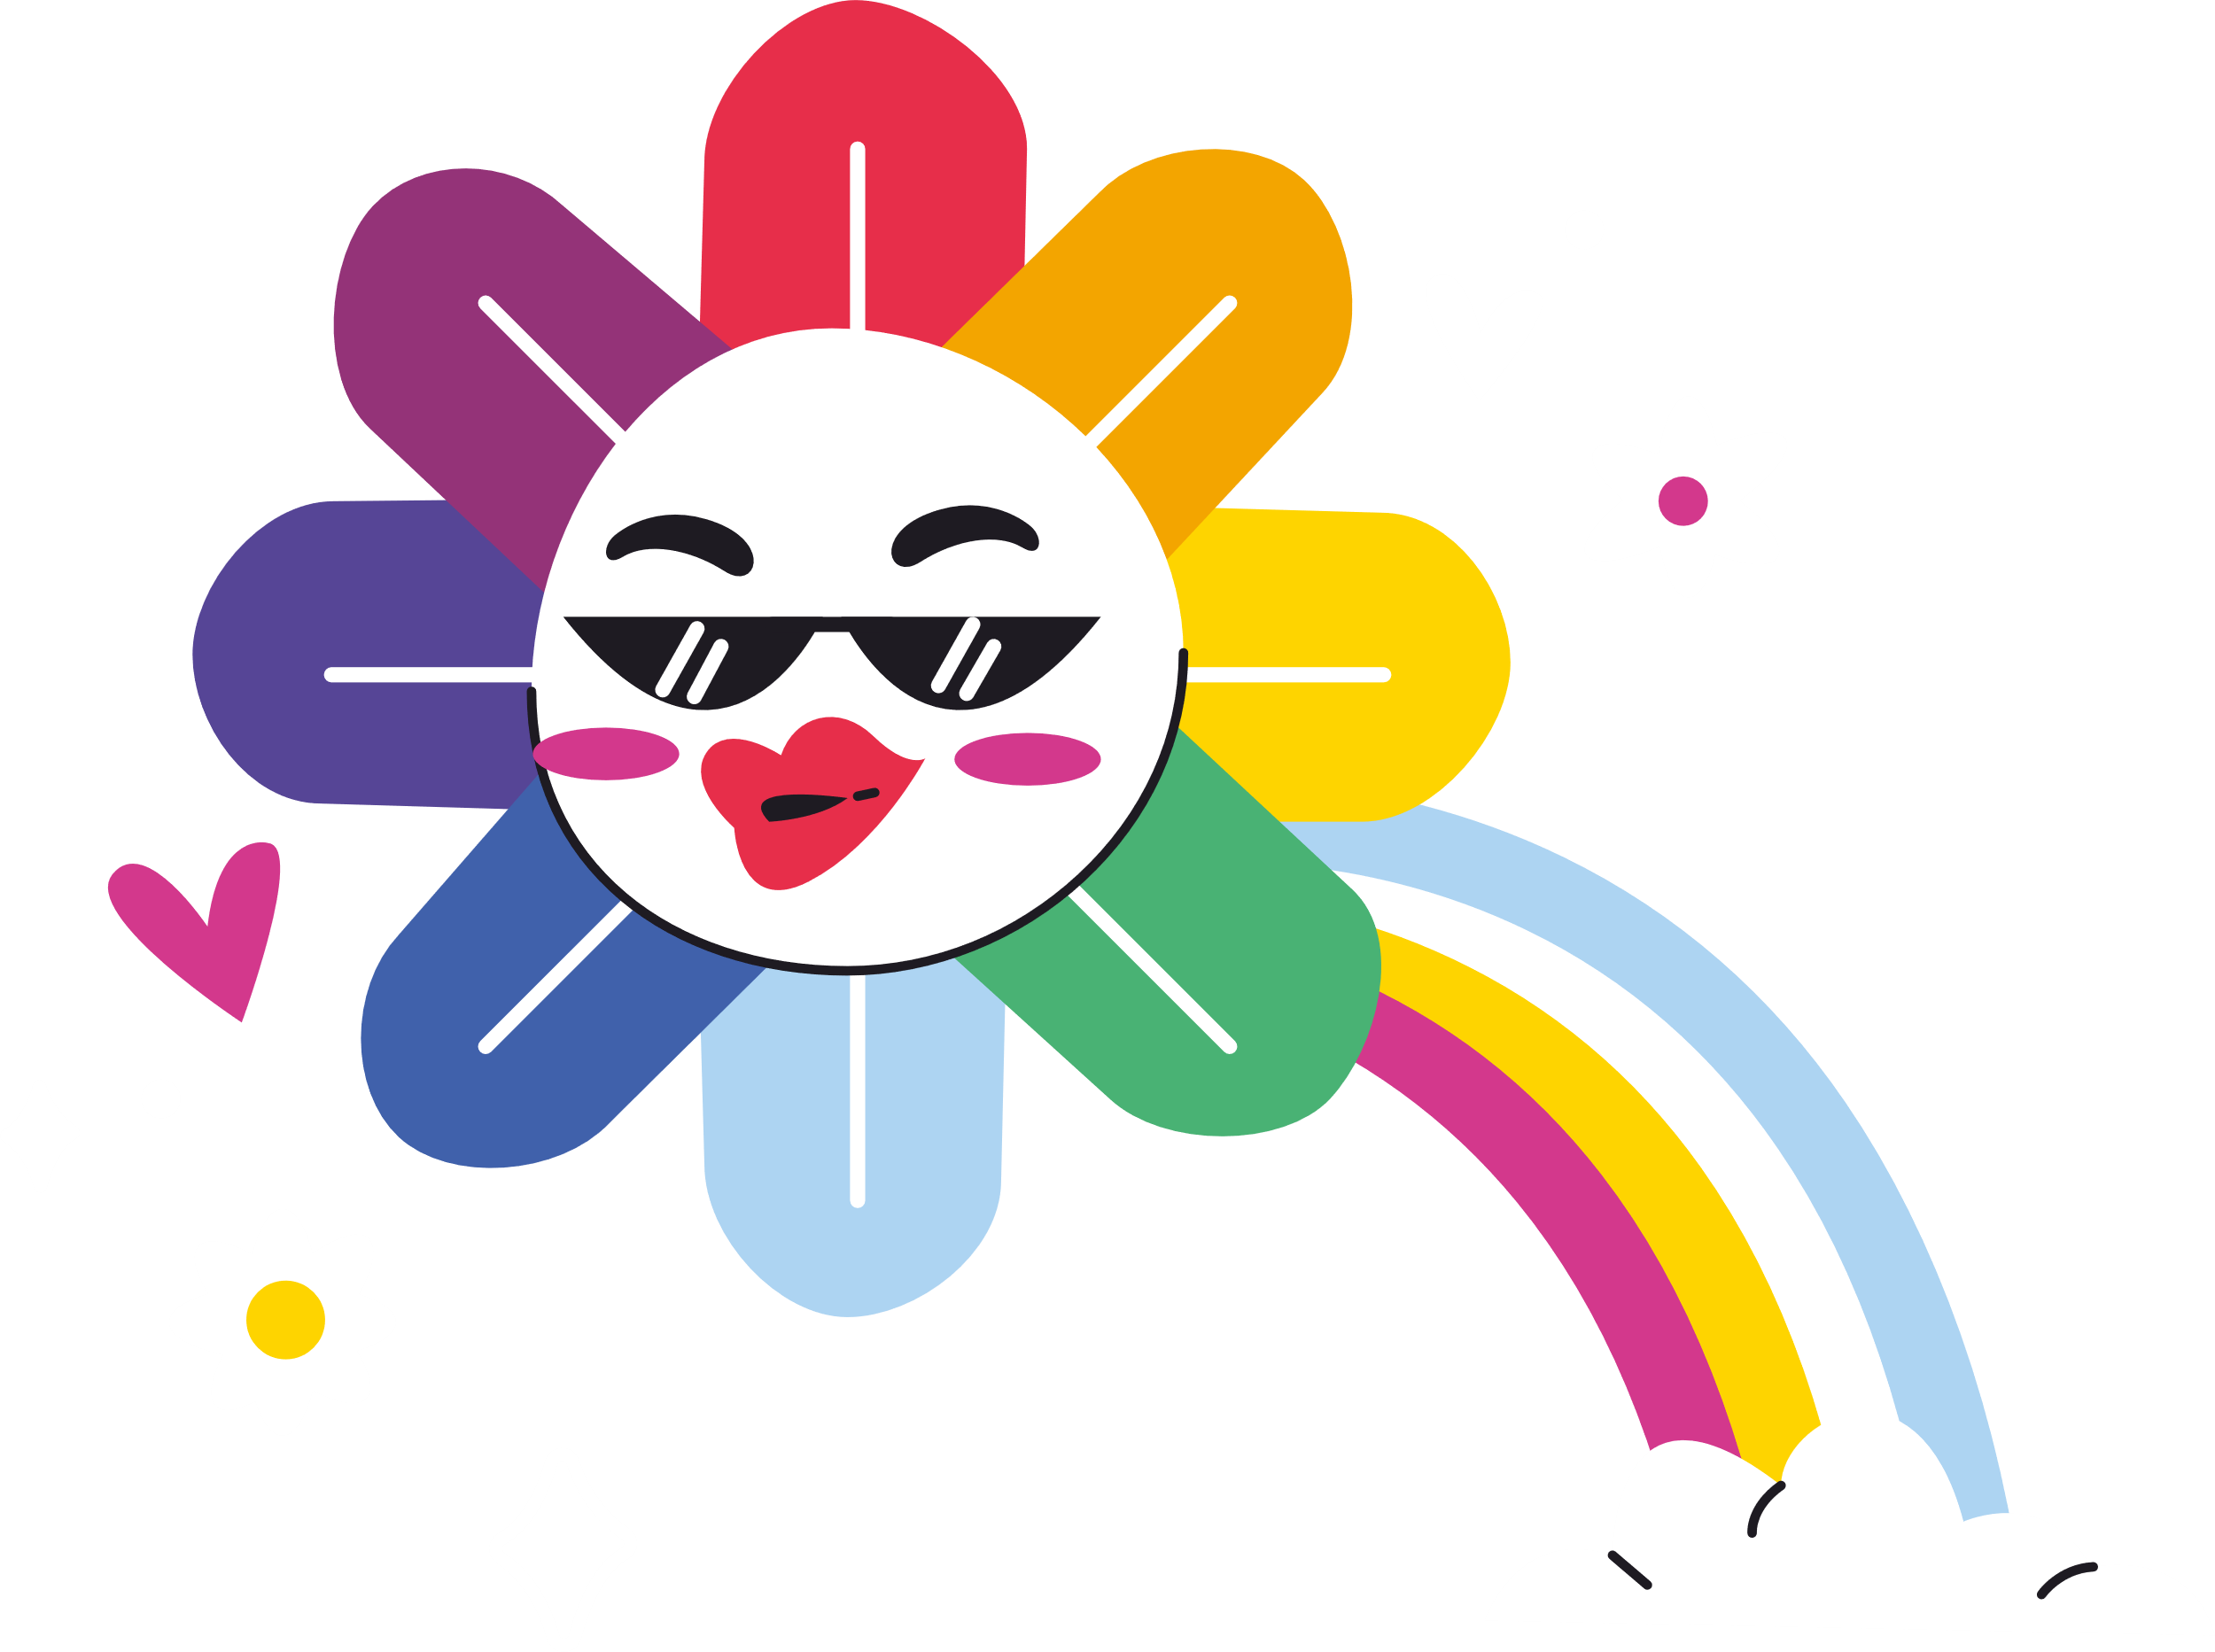
Q4. Which is the correct order of colours on the Transgender flag?
A) Blue, Pink, White, Pink, Blue
B) Pink, Blue, White, Blue, Pink
C) White, Pink, Blue, Pink, White

Slide 6
Q5. Which UK footballer became the first openly gay professional in the sport?
A) Justin Fashanu
B) Jake Daniels
C) Robbie Rogers

Slide 7
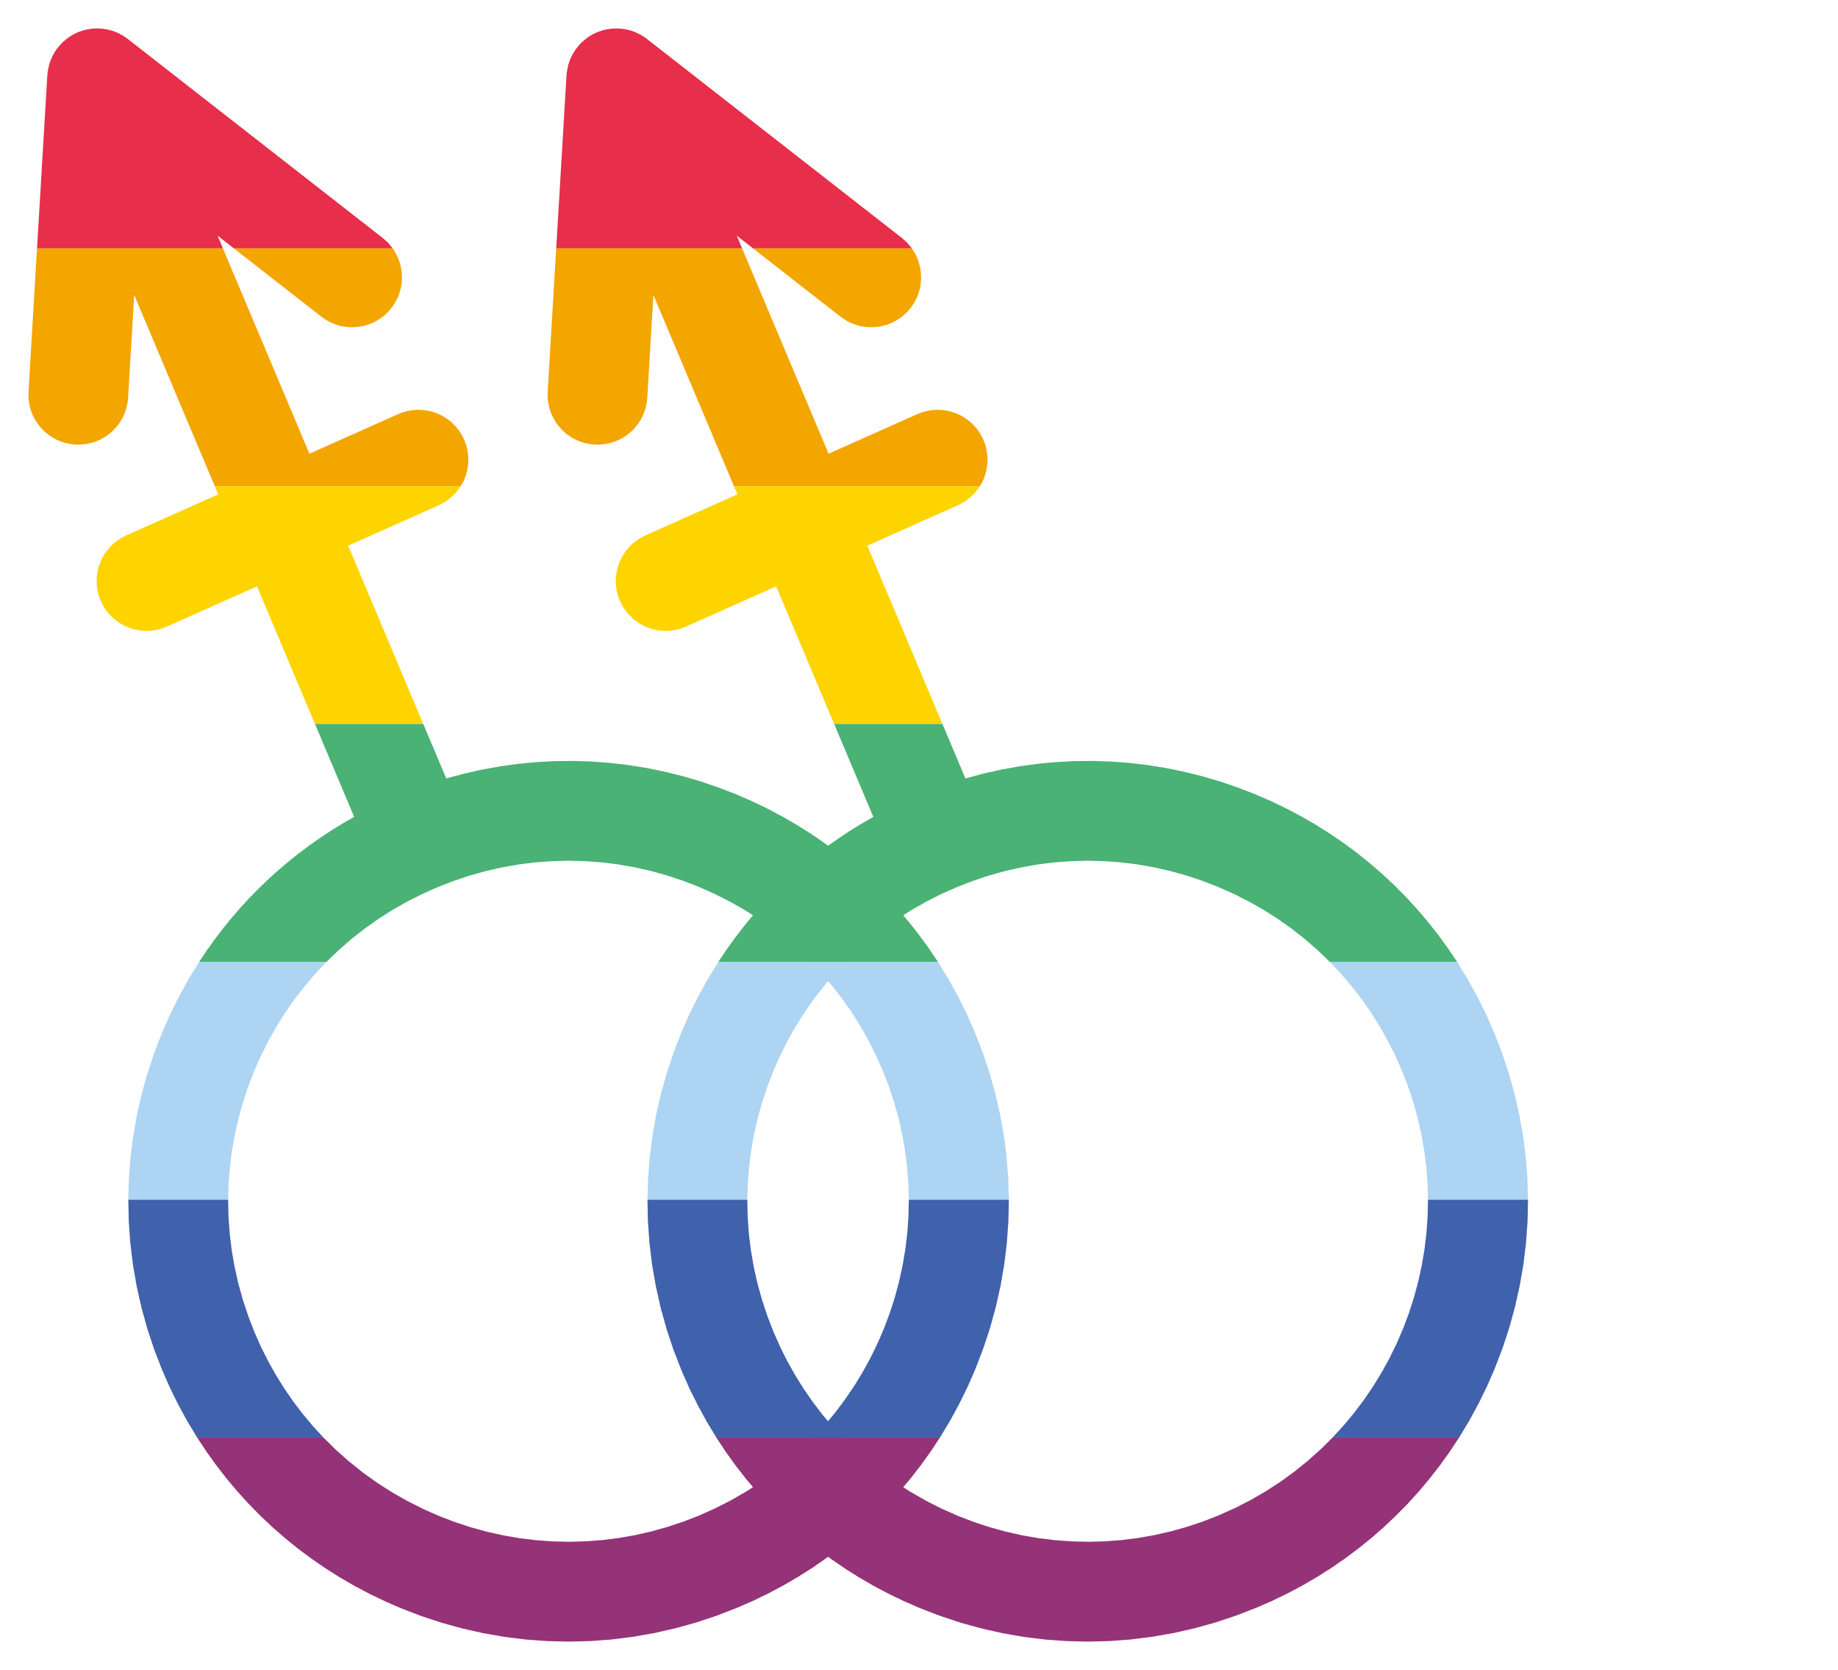
Q6. Who does this flag represent?
A) Bisexual people
B) Aromantic people
C) Non-binary people

Slide 8
Q7. When was the term bisexual coined?
A) 1859
B) 1952
C) 1992

Slide 9
Q8. Where in the UK was the first Pride event held?
London
Cardiff
Manchester

Slide 10
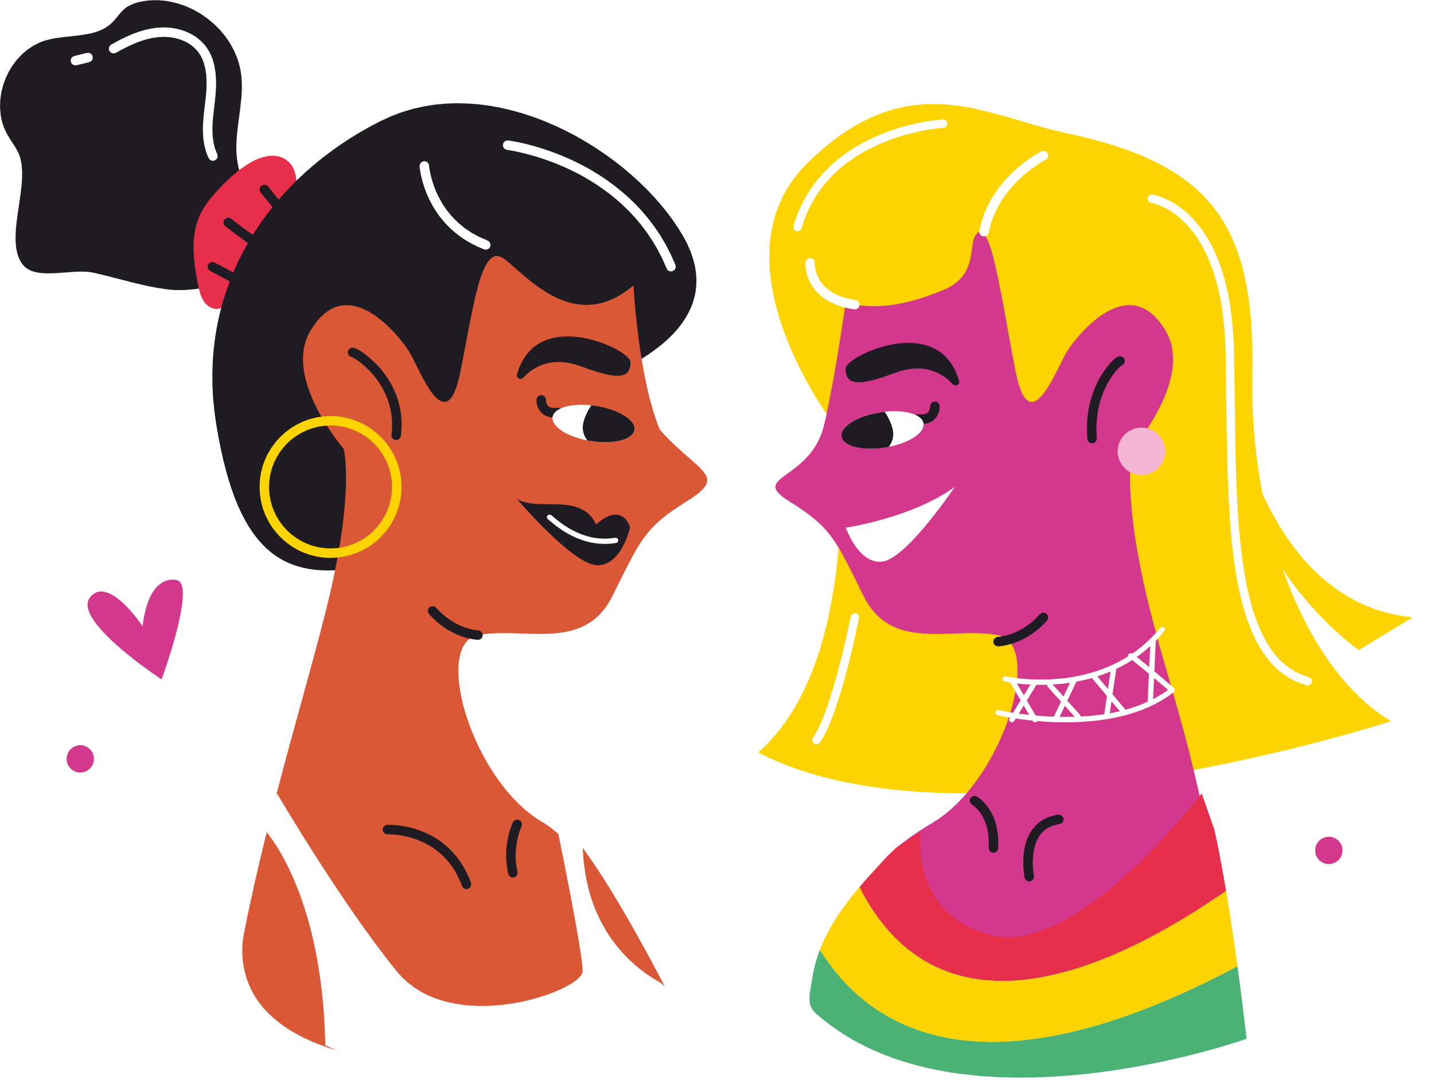
Q9. The UK charity set up to support transgender and non-binary children and young people shares its name with which mythical creature?
A) Unicorns
B) Mermaids
C) Pegasus

Slide 11
Q10. Finally, as of 2022, how many countries continue to criminalise homosexuality?
A) 68
B) 70
C) 72

Slide 12
Q11
Of those countries, how many of them still enforce the death penalty for homosexuality?
A) 4
B) 8
C) 11

Slide 13
Q12
Which of the following statements is untrue?
A) Half of LQBTQ+ people have experienced depression
B) Reports of homophobic hate crimes have more than doubled in the past five years
C) Almost half of all trans people have thought about taking their own life
D) 3 in 5 LQBTQ+ people experience regular anxiety

