Slide 1
Shirebrook Health Inequalities and Vaccine Hesitancy Report
Steve Morris Head of Bolsover CVS
Debbie Fennell Bolsover CVS Engagement Lead
Sophie Maher Service Development Officer, Health Protection, Derbyshire County Council
Lorna Sumner Project Officer, Health Protection, Derbyshire County Council
Alison Tranter Advanced Public Health Practitioner, Health Protection, Derbyshire County Council
April 2023
Community Trusted Voices
Approach to Resident Feedback on the Wider Determinants of Health

Slide 2
Shirebrook
Bolsover District contains some of the most deprived areas in Derbyshire, Some of these being Langwith, Shirebrook South and Pleasley MSOA.
This MSOA also contains the Low vaccination uptake LSOAs.
Bolsover has been disproportionality affected by covid-19 as it contains the highest rates of Deaths with COVID-19 on the death certificate in Derbyshire.
From intelligence from the community, we know that many individuals originally from Eastern European countries reside in Shirebrook. Prior to the covid-19 Vaccination rollout of the first dose it was identified that there would be some barriers to vaccination uptake from certain groups such as those living in areas of Deprivation and Ethnic Minority groups.

Slide 3
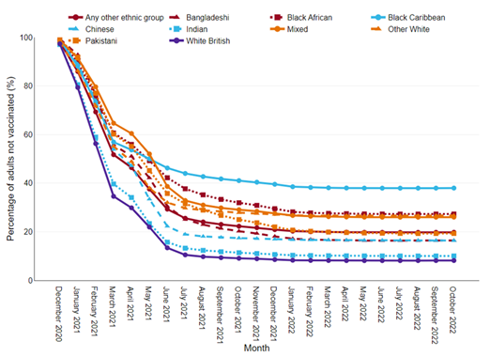
Need
Cumulative percentage of adults aged 18+ who have received three COVID-19 vaccinations in England, by national deprivation quintile, November 2021 to October 2022
Cumulative percentage of adults aged 18+ who have not received a vaccination in England, by ethnic group, December 2020 to October 2022
Source: COVID-19 Health Inequalities Monitoring for England (CHIME) tool

Slide 4
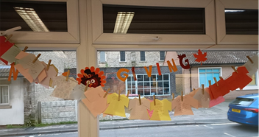
Approach
Pants and tops

Slide 5
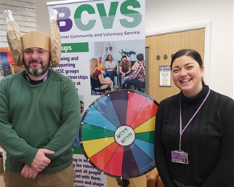
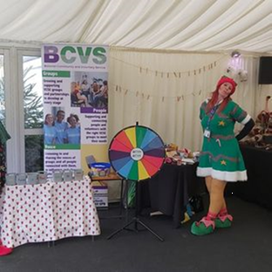
Approach
Spin the wheel

Slide 6
Partners

Slide 7
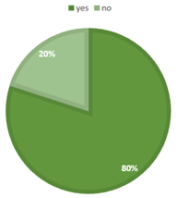
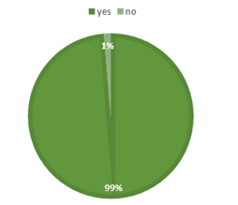
Findings
92% of people engaged across all venues had received at least one Covid-19 vaccination
The highest community group that had taken up the vaccine was Shirebrook rangers with 74/75 people indicating they had received the minimum of 1 vaccination
The group with the lowest uptake of the Covid-19 vaccine was Derbyshire Unemployed Workers Union. This group completed engagement with the migrant community of Shirebrook.

Slide 8
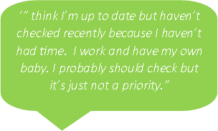
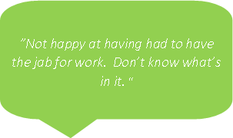
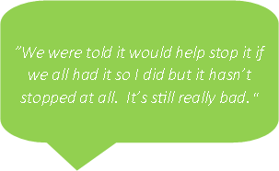
Findings
‘I’m not having any more. We were told it would stop COVID but it hasn’t stopped at all. We’ve still got it. It doesn’t do anything.”
“I’ve never had any problems with regular periods before I had the COVID jab. After it I’ve had nothing but problems. I honestly believe it was the jab that caused it. It couldn’t have been anything else.”
“I've had my COVID jabs but only because I am a full-time carer and I didn't want them to be at risk. I don't want the flu jabs or any others. I have a needle phobia. They were good with me though when I went for my COVID jabs. I told them about my phobia and they were very nice about it.”
“I am not having it. Not putting something that was rushed into my body.”
“I've had the first 2 but I've since had COVID 5 times so it doesn't do anything. I'm not having any more. We were told it would stop COVID but it hasn't. We've still got it. It doesn't do anything. There is no point in having any more.”

Slide 9
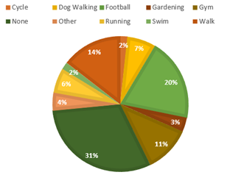
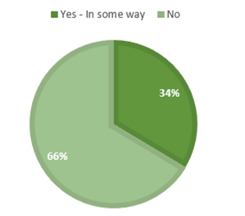
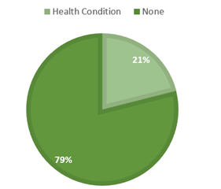
Findings
How often do you undertake physical activity?
Have you ever accessed mental health support?
Do you have a recognised health condition?

Slide 10
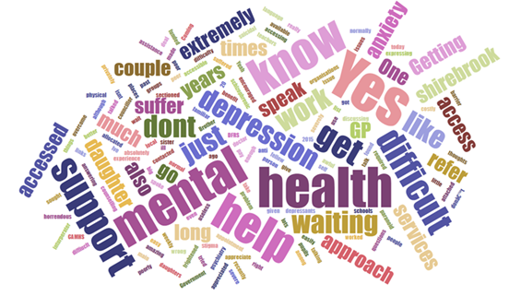
Findings

Slide 11
Findings
Sense of community
Community projects
Green spaces
Antisocial behaviour
Fear of crime
Opportunity for youths
Appearance of area
Lack of investment
Shopping facilities
Unreliable public transport
Employment opportunities
Access to GPs

Slide 12
Recommendations
Themes | Recommendations
Low uptake of the Covid-19 vaccination amongst certain groups | ¨ Work directly with trusted voices in Migrant Communities. Continue to build trust and partnership ways of working to pass on positive health messaging. Encourage more feedback on health access experience in the UK. This would not just be for Covid- but for all health messaging. Derbyshire Unemployed Workers Union for example are a great conduit to this community.
Trust | ¨ Clearer resources supporting vaccine information regarding ingredients and testing co produced with the community to ensure appropriate resources created for different groups from the outset. ¨ Engaging with different communities through their trusted leaders and peers, utilising organisations that already support these groups to share information.
Good Access to Vaccinations | ¨ Use lessons learned from the review of the roving vaccination clinic model for future interventions.
Feeling Mislead and 3rd Dose/booster uptake | ¨ Including information on purpose of vaccination in guidance to trusted leaders including clearer information on protecting yourself, protecting others and vaccinations don’t stop individuals for contracting the virus, but can reduce the possible harmful illness. This could also include the wider impact of time off work and the impact this has on the economy.

Slide 13
Recommendations
Themes | Recommendations
Lack of Pride in the area from the community | ¨ Engage young people – from toddler up – get them to own their community, murals, walks, conversations. Make the first steps of the generation change, so we can alleviate health inequalities.
Low rates of Physical Activity | ¨ More resource put into Shirebrook for community led physical provision. E.g. Walk and Talk. This must be led by community champions who are advocates. ¨ As an already established group Shirebrook Rangers could look to diversify their model to incorporate other physical activity initiatives. ¨ Review transport and connectivity – community transport model to allow people, with an emphasis on young people to access the swimming pool in nearby Clowne. ¨ Work with Holiday Activities and Food Programme to develop an offer that is appropriate for the community . ¨ More youth led community leaders! ¨ Use good access to green space as a way of engaging with Eastern European community.
Access to other services and support | ¨ Work with Cost of Living support (warm hubs, food banks) to relay health messages. ¨ More low-level community-based intervention to support people to improve emotional wellbeing. This could be linked with physical health provision. ¨ Review of Improving Access to Phycological Theories (IAPT ) and how to access Mental Health support within the town.

Slide 14
Next Steps

