Slide 1
Bassetlaw VOICES
2nd February 2023
Listening to and sharing the voices of groups and all people connected to them, to influence and shape policy, funding, services and communities.

Slide 2
Partnership Ecosystem and values Bassetlaw has a long history of very strong partnership working which has resulted in a partnership support ecosystem which is agile, responsive, and provides impactful support for our local population. Ingredients: Good understanding of need and what works in this place, plus diverse, trusted, and valued partners who ALL go the extra mile.
We know our partners in the BPBP/NHS and BDC are fighting hard alongside the VCSE sector to protect what they know works well at place.

Slide 3
The BIG issues – Ongoing
£

Slide 4
Individual VCSE Groups, networks and projects
(BFIN, POV, TLC, BHN etc etc)
Volunteer Forum
VCSE Health and Wellbeing Forum (Officers)
VCSE Leaders Group
Bassetlaw VOICES
Place Collaborative
CYP Forum, Mental Health Forum, Financial Inclusion Forum etc
Health Inequalities Forum
Public and Third Sector Partnership
BPBP Cabinet
BPBP
VCSE Alliance
NNICP
NNICB
Meetings and voice

Slide 5
Impact of reduced
VCSE funding at place
Survey conducted w/c 26th January
9 VCSE organisations have completed a survey designed to capture predicted impact
8 previously funded and applied for VCSE BPBP funding
one not previously funded and did not apply

Slide 6
An average of 38% application value of funding awarded (some respondents 0%)
5 Services at RED status
5 Services at Amber status

Slide 7
How many service users will you NOT be able to support as a direct impact of this funding decision?
3295
and a further 8565 service users will
be indirectly affected

Slide 8
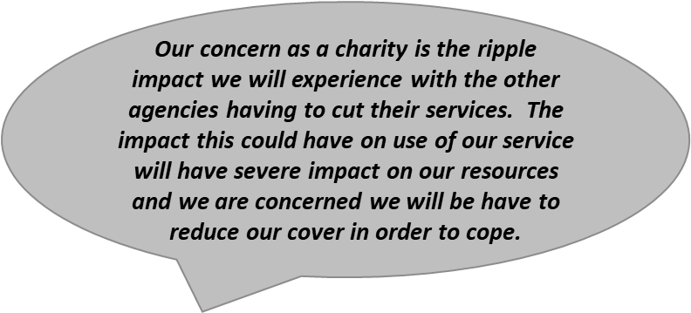
The Ripple Effect
Robert Garland, Manager, Bassetlaw Foodbank

Slide 9
Through all channels, BCVS will continue to work to amplify the voices and
impact of the work of the Bassetlaw VCSE sector and the impact of
decisions and cuts on the communities we exist to serve.

Slide 10
VOICES and Further feedback
We previously agreed partner feedback will top the agenda to give more space and time for feedback in the voices meeting.
However there is always space for more, over to you…

