Slide 1
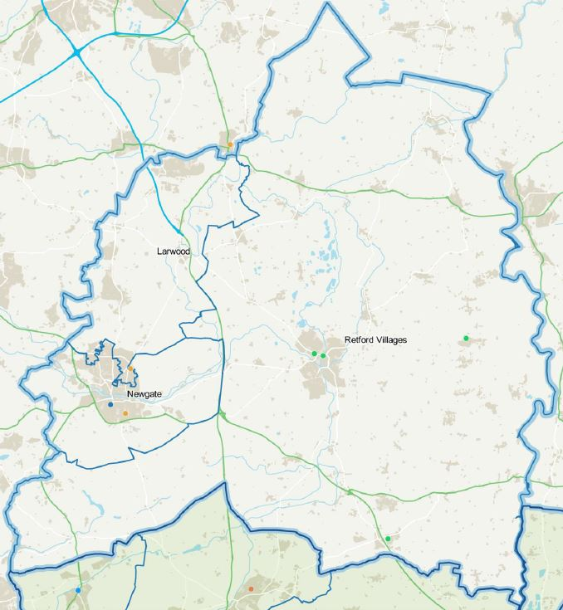
Bassetlaw Voices Workshop
Victoria McGregor Riley
Locality Director for Bassetlaw & Mid Notts Place Based Partnerships
Nottingham & Nottinghamshire Integrated Care Board

Slide 2
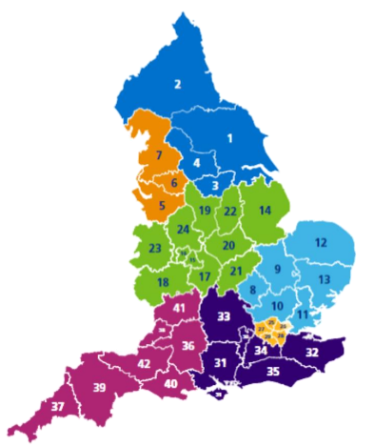
What is an ICS 42 partnerships of health and care organisations in England
They have four aims:
1. Improve outcomes in population health and healthcare
2. Tackle inequalities in outcomes, experience and access
3. Enhance productivity and value for money
4. Help the NHS support social and economic development

Slide 4
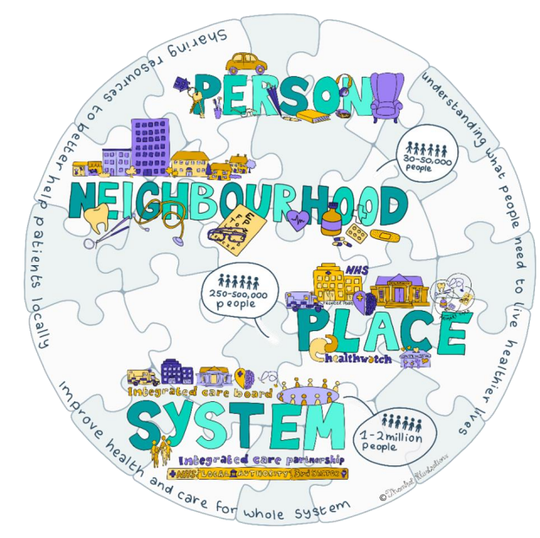
What’s different and what’s new?
We’re coming together in a way we haven’t before.
To unite with a single strategic vision.

Slide 6
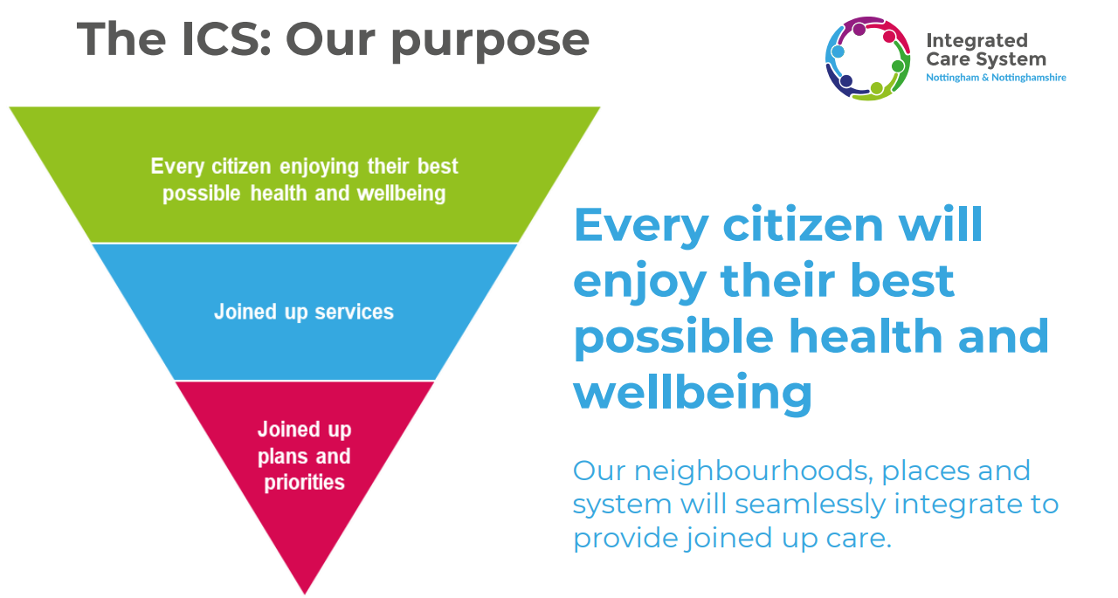

Slide 7
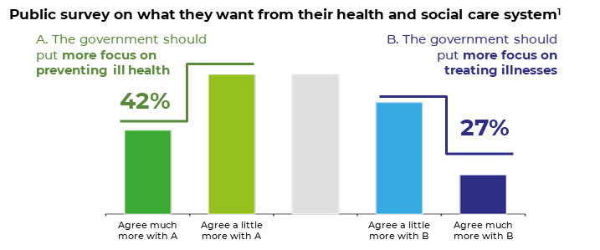
A shift towards prevention
People in our ICS are dying earlier than they should...
…and living with illness and disability longer
Our system has a significant challenge with deprivation…
…and the public want a shift towards prevention
Notes:
We know that our communities are changing. Populations are growing and becoming more diverse. The proportion of older people is increasing and many of us are living with more complex health and social care needs. Differences in health are also widening between social groups, as seen during the COVID pandemic.
Finances for all are challenging at present, with many people struggling with rising costs for essentials and services under pressure to respond to their needs. We need to support our communities and deliver the most effective, efficient services that deliver the best outcomes for our population.
It is widely agreed that, if possible, prevention is better than cure in terms of improving the health and wellbeing of our population, but also managing demand today, tomorrow and in the future.
People in our ICS are dying earlier than they should...
Large disparities in life expectancy exist across our ICS.
Males in Nottingham City can expect to live 6.6 years less than males in Rushcliffe.
Outcomes inequalities are faced by our minority communities.
For example women from BAME backgrounds in NN are significantly more likely to die during childbirth than white women.
Some of our places are have the worst child poverty mortality nationally.
Nottingham City is amongst the 10 worst areas in England for child poverty mortality.
…and living with illness and disability longer
Morbidity is prevalent in our disadvantaged populations.
Diabetes morbidity is 2.93x higher in Black and Asian populations and 2.37x higher in the most deprived populations.
Parts of our system are disproportionately affected by long term conditions (LTCs) and disability.
Despite its young age, Nottingham’s rate of people with a limiting long-term illness or disability is higher than average.
Our system faces a significant challenge with smoking.
Mansfield has the 4th worst smoking rates in England. Smoking in pregnancy rates in parts of Nottingham and Nottinghamshire are much higher than average.
Our system has a significant challenge with deprivation…
Some of our communities are amongst the most deprived nationally.
Some communities in Ashfield, Mansfield, Newark and Sherwood are in the 10% most deprived areas in England.
The two most deprived places in NN ICS have the greatest LTC prevalence.
Mid-Nottinghamshire and City of Nottingham have the highest prevalence of hypertension, coronary heart disease (CHD) and diabetes.
…and the public want a shift towards prevention
Source: 1. Summarised findings from ‘Public Perceptions of Health and Care’, a study by Health Foundation and Ipsos Mori

Slide 8
1. Improve outcomes in population health and healthcare
Our Priorities | What will we do? | How will we know we’ve got there?
We will support frail older people with underlying conditions to maintain their independence and health | Focus on frail older people with underlying conditions to support them to stay well, remain independent and avoid unnecessary admissions to hospital in the short term. | Target: a 10% reduction in emergency admissions to hospital.
We will support children and young people to have the best start in life. | Support children and young people to have the best start in life by delivering our six physical health transformation programmes and with a particular focus on obesity. | Target: a 50% reduction in children who are classed as obese by age 11.
Make every contact count for traditional areas of health for example mental health / healthy lifestyle AND incorporate signposting to other services like financial advice which also affect people’s health | Ensure that all staff understand the building blocks of health and health inequalities and are able to deliver brief interventions on a range of topics to support people’s wellbeing. | Target: All staff have access to a local bespoke training model to build their confidence and competence in delivering health and wellbeing advice.
DRAFT

Slide 9
Next Steps
By end of March 2023, there will be development of more detailed delivery plans, including the ICB and NHS Trusts Joint Forward Plan and outcomes framework
Final version of the strategy text to be confirmed by 30 November
Design and copywriting completed between 1 – 7 December
Papers for the ICP published 8 December
ICP meeting on 16 December to agree the strategy
Formal launch of the strategy after this meeting in late December

Slide 10
Bassetlaw Place Based Partnership within the Nottingham and Nottinghamshire ICS

Slide 11
Key roles of the Place-Based Partnerships
• Develop and deliver community service transformation, bringing primary, social and community health services together to improve outcomes
• Develop population health management – understanding health needs and targeting interventions where they are most needed (health equity)
• Support general practice, including the development of additional and new roles
• Enable and help to coordinate the development of PCNs, incorporating local community partners
• Implement health interventions that improve inequalities (e.g. CORE20Plus5 – 20% most deprived areas and 5 biggest disease contributors to inequalities)
• Work with the ICB to integrate NHS and local government services and funding where this will improve outcomes
• Come together as partners with communities to codesign services and help to make citizens’ lives better

Slide 12
Community Insight Bassetlaw
There are 118,280 people living in Bassetlaw- 8% of the population live within the 10% most deprived areas across England and 20% live in 20% most deprived areas
There are 30,700 children and young people within Bassetlaw,16% (0-19) live in relative low-income households, compared with 19% across England. 12% live within absolute low income households compared 15.4 across England.
1% of households lack central heating in Bassetlaw September 2022 compared with 3% across England
The overall crime rate is higher than the average across England

Slide 13
Community Insight Bassetlaw
22% of people have a limiting long-term illness in Bassetlaw September 2022 compared with 18% across England
28% of people have no qualifications in Bassetlaw September 2022 compared with 22% across England
38% people aged 16-74 are in full-time employment in Bassetlaw September 2022 compared with 39% across England
20% of households have no car in Bassetlaw September 2022 compared with 26% across England
The % of people 'satisfied with their neighbourhood' (73.5%) is lower than the average across England (79.3%)

Slide 14
Health of Bassetlaw
Life expectancy for both men and women is lower than the England average- with even lower rates of 8.7 years for men and 6.9 years for women in the most deprived areas compared most affluent areas of Bassetlaw
Bassetlaw has higher rates of childhood obesity at 23.7% in compassion to the England average at 21%
Estimated levels of excess weight in adults (aged 18+) are worse than the England average.
Levels of breastfeeding and smoking in pregnancy are worse than the England average.
Bassetlaw has a significantly higher rates of suicide at 14.6% per 100,000 population in comparison England average 10.4%

Slide 15
Bassetlaw Place Priorities

Slide 16
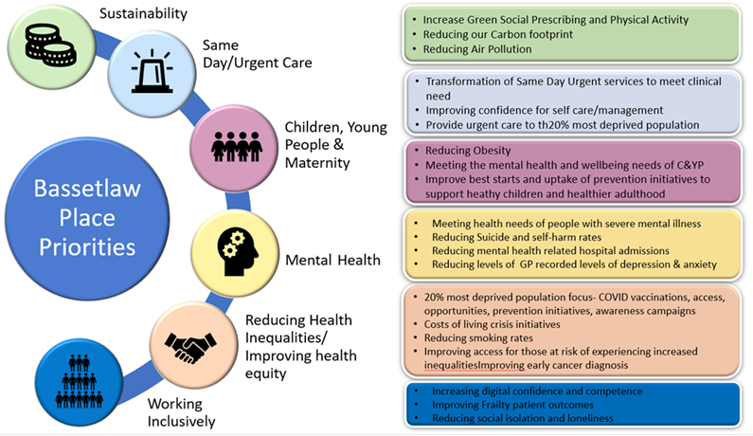

Slide 17
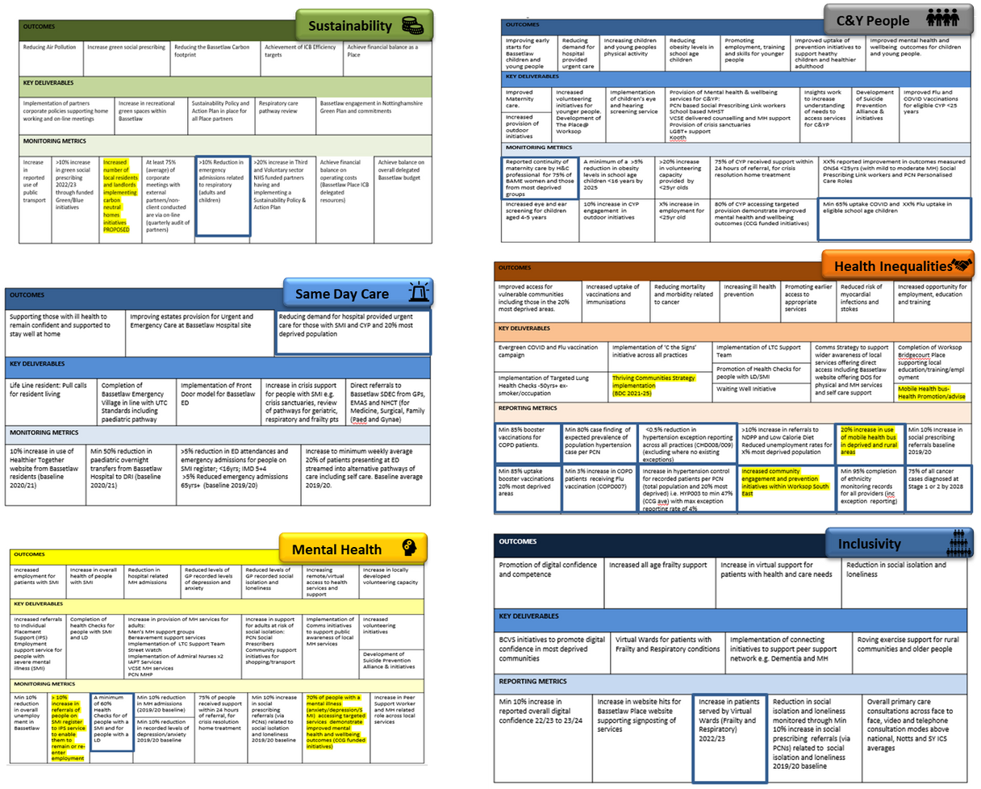
How we will know we are on track
We have developed a Place Dashboard of our key objectives and the projects and initiatives we will work on together to achieve them. This includes those projects that support delivery of the NHS Core20+ expectations. Our Dashboard fully reflects the Nottinghamshire Health and Wellbeing Strategy. Further work will be undertaken in 2022/23 to reflect the work we will be doing to establish the way we work together as well as what we work together on.

Slide 18
Bassetlaw Place Delivery
Preparing for Winter

Slide 19
Managing Demand
Key messages
High level of demand at Bassetlaw ED, support to help flow
Pressures on recovery of elective care
BUT
Bassetlaw practices providing same level of access as pre COVID
Access higher than national average
Good patient satisfaction via national patient survey

Slide 20
Working in Partnership
Bassetlaw Grant Fund Initiative 2023/24

Slide 21
Timescale of Process
November 2022
Initial notice of grant funding process
W/C 21/11/22
Commissioning intentions workshop to be held to set the scene and inform detailed application process
22 November – 9th December 2022 Application process open for providers to submit
15th December 2022 – 12 NOON
Closing date for applications to be submitted
W/C 26th December 2022 (this is subject to change) Provisionally, you will receive outcome of funding
W/C 19th December 2022 (this is subject to change) Provisionally, the grants panel will meet the
16th December 2022
BPBP Administration process to collate application panel pack

