Slide 1




Bassetlaw VOICES
Voice = listening to and sharing the voices of groups and all people connected to them, to influence and shape policy, funding, services and communities.

Slide 2
Partnership Ecosystem
Bassetlaw has a long history of
very strong partnership working
which has resulted in a partnership support ecosystem which is agile, responsive, and provides impactful support for our local population.
Ingredients:
Good understanding of need and what works in this place, plus diverse, trusted, and valued partners who ALL go the extra mile.

Slide 3
The BCVS mission is to support development of a sustainable, inclusive and healthy VCSE sector for Bassetlaw and Bolsover.
We do this through our proactive support for VCSE Groups, People and Voice, which enable better communities for everyone.
Voice = listening to and sharing the voices of groups and all people connected to them, to influence and shape policy, funding, services and communities.
BCVS represents and advocates for the VCSE sector at dozens of meetings each month at place/district, system/county and nationally to affect change.

Slide 4
Individual VCSE Groups, networks and projects
(BFIN, POV, TLC, BHN etc etc)
Volunteer Forum
VCSE Leaders Group
Bassetlaw VOICES
Place Collaborative
CYP Forum, Mental Health Forum, Financial Inclusion Forum etc
Health Inequalities Forum
Public and Third Sector Partnership
BPBP
VCSE Alliance
NNICP
NNICB
Meetings and voice

Slide 5

The BPBP
Ecosystem BPL

Slide 6


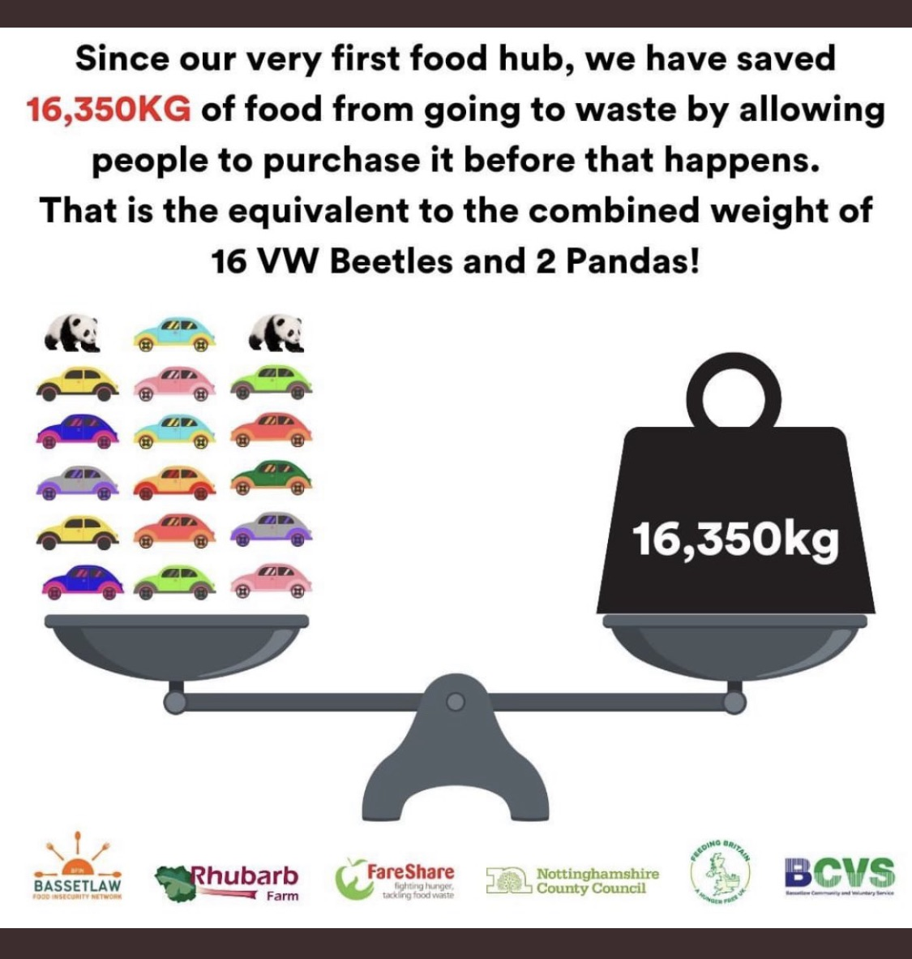




Examples of current
Place partnership working
The BCVS mission is to support development of a sustainable, inclusive and healthy VCSE sector for Bassetlaw and Bolsover.
We do this through our proactive support for VCSE Groups, People and Voice, which enable better communities for everyone.
Voice = listening to and sharing the voices of groups and all people connected to them, to influence and shape policy, funding, services an communities.
BCVS represents and advocates for the VCSE sector at dozens of meetings each month at place/district, system/county and nationally to affect change.

Slide 7
https://www.ncvo.org.uk/news-and-insights/news-index/uk-civil-society-almanac-2022/profile/#/
(2021 data below, 2022 place data has been requested
and will be shared as soon as available)

Slide 8


The BIG issues
£

Slide 9
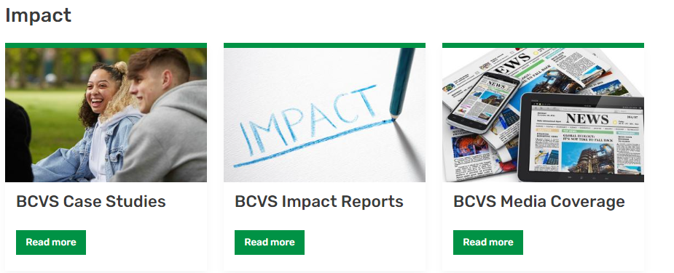

Demonstrating VCSE Impact
(examples from BCVS and how BCVS is seeking to raise the profile of impact of partnership working)
Impact | Bassetlaw CVS (bcvs.org.uk)
https://socialvalueuk.org/resource/the-pioneers-post-quick-guide-to-social-value/

Slide 10
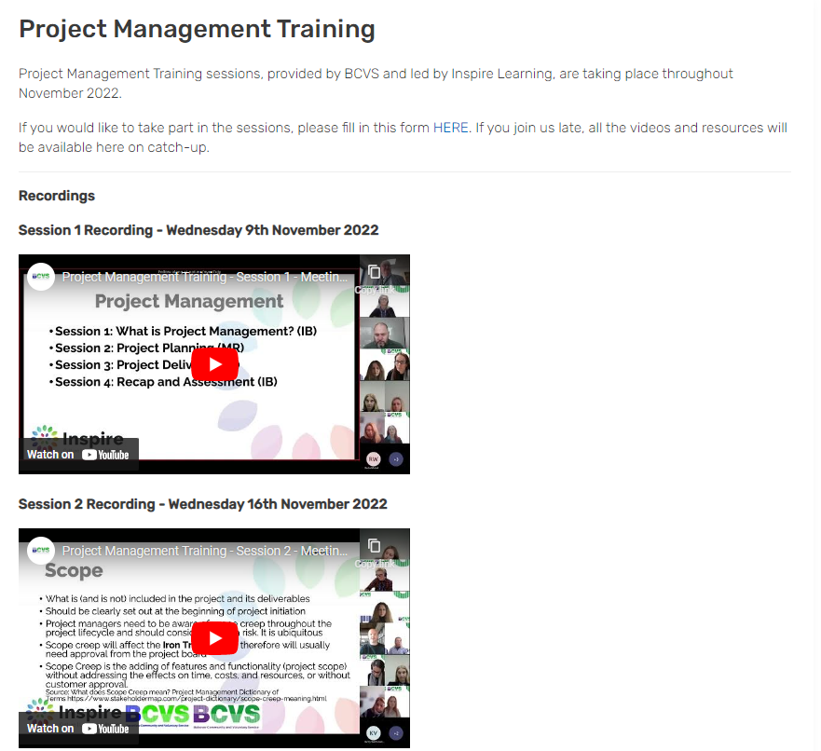
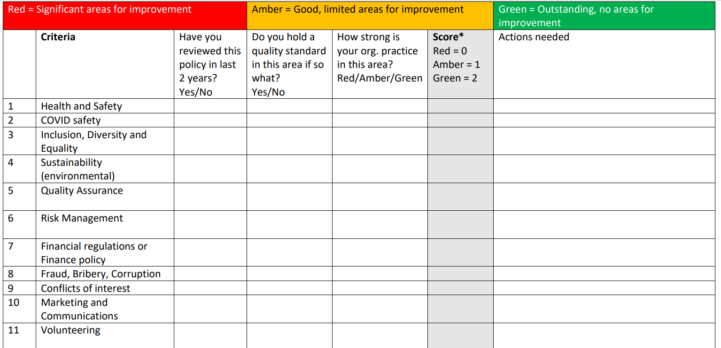
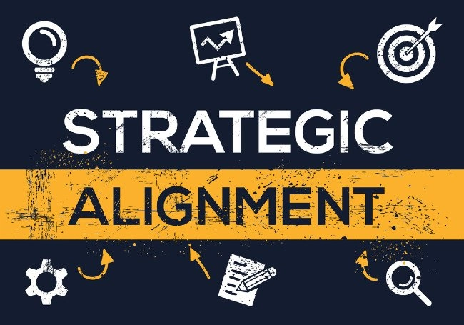
Building Capacity
Project Management Training | Bassetlaw CVS (bcvs.org.uk)
https://www.bcvs.org.uk/sites/default/files/2022-11/Consortia%20Self%20Assessment%20RAG.pdf

Slide 11
VOICES and Feedback
Views, risks, issues and success
from your organisation?

