Slide 1
Strategic Review messaging
Please be aware the information on this presentation is accurate at the time of the workshop.
Make sure you keep updated with the website, as this will have the most current information on.
Notes:
Overview of agenda & purpose of the session.
Return to our main funding offers after a period of short term emergency funding inc. Lottery & DCMS distribution.
Some slight changes as a result of previous learning, alongside learning and ongoing response to Covid.
Reminder that this isn’t a call to funding and that the demand for our funding is higher than ever. Unfortunately we have to say no to good proposals.

Slide 2
The National Lottery Community Fund
Better to Bolsover Conference
Bolsover – 17th October 2022
Jess Myers – Funding Officer
Notes:
Welcome
Introductions
Housekeeping

Slide 3
Agenda
Our purpose & priorities
Our funding offer
Who & what we can fund
How to apply
Notes:
Overview of agenda & purpose of the session.
Return to our main funding offers after a period of short term emergency funding inc. Lottery & DCMS distribution.
Some slight changes as a result of previous learning, alongside learning and ongoing response to Covid.
Reminder that this isn’t a call to funding and that the demand for our funding is higher than ever. Unfortunately we have to say no to good proposals.

Slide 4
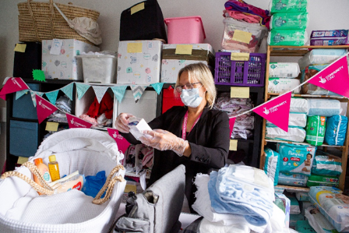
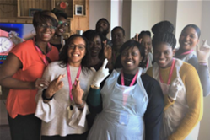
About The National Lottery Community Fund
National Lottery players contribute around £30 million to good causes every week.
The National Lottery Community Fund distributes around £600m a year to communities across the UK.
Notes:
We are a Non-Departmental Public Body (NDPB) delivering public funds, so we work at arm’s length from Government although we are ultimately accountable to Parliament and the public for our activities
The income of all the Lottery distributors comes from the sale of National Lottery tickets. Of every £2 spent on a Lottery ticket 56p (28%) goes to the "good causes".
The National Lottery Community Fund is the largest of the Lottery distributors, responsible for distributing 40% of funds raised for "good causes" (roughly 23p of every £2 spent on a Lottery ticket).
We’ve reached every parliamentary constituency and 80% of wards in England in the last three years – with 48 million people seeing a project funded in their local area.​

Slide 5
About Bolsover
Since 2015, we have invested in 119 projects totalling £3.45m.
Notes:
We are a Non-Departmental Public Body (NDPB) delivering public funds, so we work at arm’s length from Government although we are ultimately accountable to Parliament and the public for our activities
The income of all the Lottery distributors comes from the sale of National Lottery tickets. Of every £2 spent on a Lottery ticket 56p (28%) goes to the "good causes".
The National Lottery Community Fund is the largest of the Lottery distributors, responsible for distributing 40% of funds raised for "good causes" (roughly 23p of every £2 spent on a Lottery ticket).
We’ve reached every parliamentary constituency and 80% of wards in England in the last three years – with 48 million people seeing a project funded in their local area.​

Slide 6
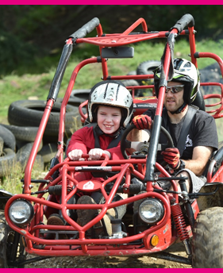
Our purpose
We support people and communities to thrive.
Our goals:
• We support ideas and activities that matter to people and communities.
• We use our funding and relationships to help create stronger, more connected communities.
• We support charities and community organisations across the UK to be vibrant, diverse and active.
Notes:
People understand what’s needed in their communities better than anyone. We listen, collaborate and fund so that good things happen.

Slide 7
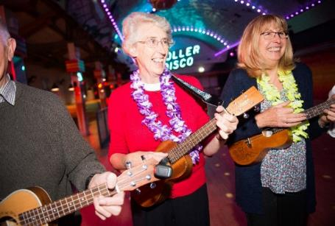
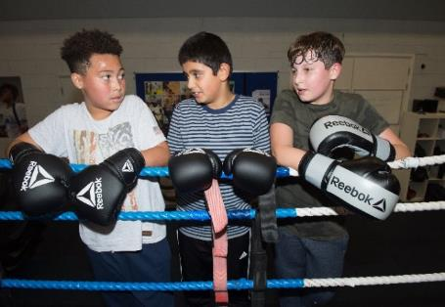
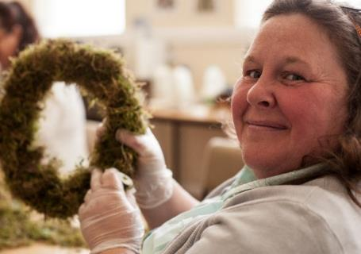
Our principles
People Led
Ensuring the people you work with are meaningfully involved in the development, design and delivery of your work.
Strengths based
Supporting people and communities to build on the knowledge, skills and experience they already have to make the changes they want.
Connected
Demonstrating a good understanding of other activities and services in the community and showing how your proposal will complement these.
Notes:
Although there are many principles which underpin this framework, we mainly consider these three things: is the organisation people led, strengths based and connected?

Slide 8
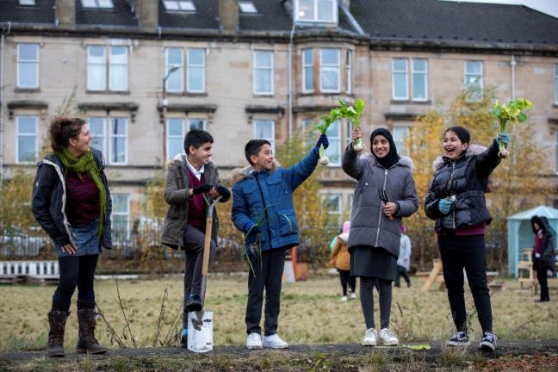
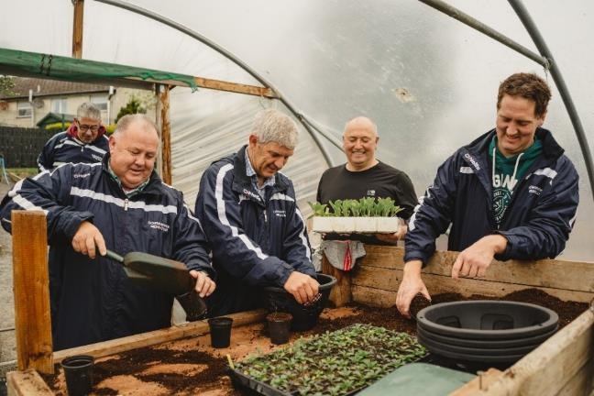
Our approach
Open to all
Flexible
Proportionate
Conversational
Notes:
Communities come in all shapes and sizes - The National Lottery Community Fund is for everyone – so we need to ensure we are reaching out to those that maybe don’t think we are for them. We ensure that our funding is meaningfully informed by lived, learned, and practiced experience, as well as the insight and knowledge that we and others have.
We are a flexible funder. This is a key part of going forward. It always has been a part, but in response to the pandemic we are now even more flexible.
It’s not just what we’ll fund that’s flexible, but our grant making processes have been refreshed and redesigned to be more flexible for applicants, allowing our processes to adapt to the different types of funding that your organisations will need, particularly whilst responding to and recovering from the COVID-19 pandemic.
Therefore we will take a proportionate approach to assessment and grant management based on the scale, size, complexity and amount that you have requested; recognising that it is not a one size fits all process. For example, we wouldn’t expect the same level of detail and information to be provided by a group that wanted £50k over a year as opposed to one that requests £500k over five years.
It’s your local funding officer’s role to assist you, so that you know how much information we need regarding the level of planning required and the amount of information to submit. Our approach remains conversational and relational despite any Covid-19 restrictions – if your idea is a good fit with our priorities we talk to groups so that we can fully understand what you want from us, and if you are successful in being awarded funding we will keep talking to you about how you are progressing with your grants until you have spent all the money.

Slide 9
Our priorities in England
Stronger relationships
We support ideas that bring people together, strengthening relationships in and across communities
Shared and sustainable places and spaces
We support people to shape and sustain the places that matter to them, like a park, community centre or online network
Early action to prevent problems and tackle disadvantage
We support activity that empowers people to fulfil their potential, working to address problems at the earliest possible stage
Notes:
We have three main funding priorities in England which came out of discussions with our grant holders, stakeholders and organisations across the voluntary sector.
We asked them where they think we add most value and what is important for their communities.
These priorities are the same for all England funding.

Slide 10
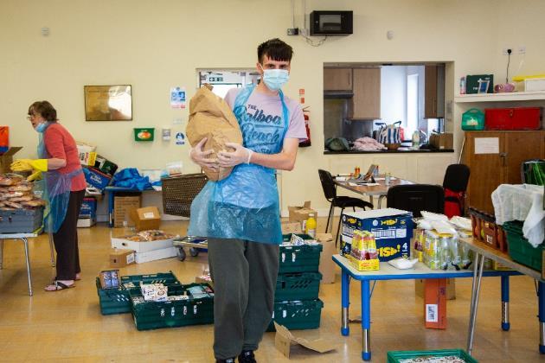
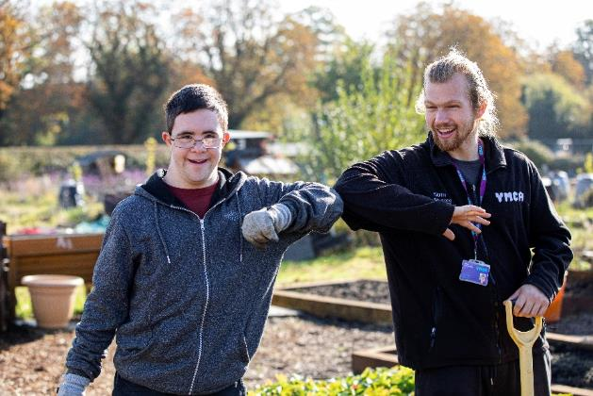
Our priorities in response to the pandemic
We'll continue to support people and communities most adversely impacted by COVID-19.
We want to do more than support organisations to survive; we want to support communities to thrive and grow.
Notes:
Alongside the 3 main England priorities, we will continue to prioritise proposals which respond to the crisis.
We can support groups to:
- continue to deliver activity, responding to the immediate crisis or recovery
- change, adapt and become more resilient to respond to future challenges.

Slide 11
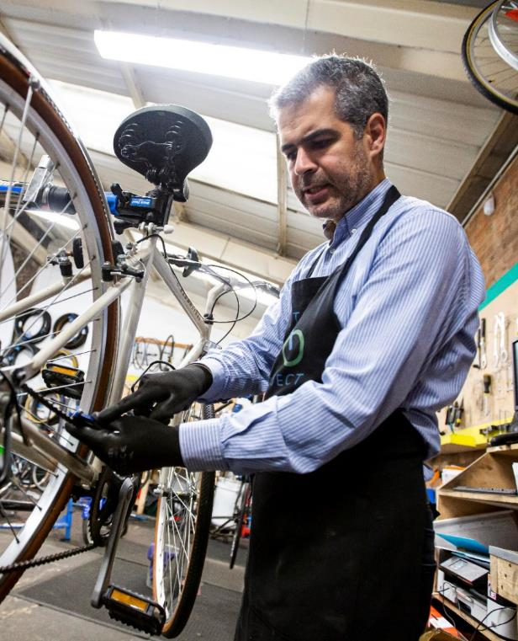
Our funding offer
Have a look at our website for
National Lottery Awards for All
Reaching Communities & Partnerships
All applications should go through
the website unless you have specific
communication requirements.
Notes:
We’ve now re-opened our main responsive funding programmes.
These are the same programmes that operated before our short-term Covid emergency funds – with a few small changes.
All open programmes can be found on our website: https://www.tnlcommunityfund.org.uk/funding/programmes?location=England

Slide 12
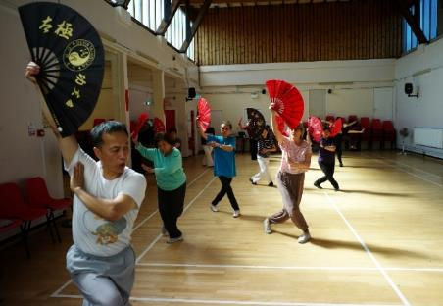
National Lottery Awards for All
Grants from £300 up to £10,000 for one year
Can apply at any time
Only one award in any 12 months, unless you want funding for Jubilee activity
Applications are on-line using a response to 3 questions
Decisions typically within 12 weeks
Notes:
Our most popular programme in England.
Supporting smaller grassroots organisations.
Managed by our teams in Newcastle and Birmingham.
The Awards for All programme is now accepting applications that celebrate the Platinum Jubilee. These should still meet our standard aims and eligibility criteria. Although not a requirement, the strongest projects will also promote relationships across generations or develop the skills and experience of communities or encourage the care of/action in the natural world as part of the celebrations. In order to support your project starting on time applications for funding for Jubilee projects should be received no later than 31 March 2022.

Slide 13
Reaching Communities & Partnerships
We can fund individual organisations or partnerships
Grants from £10,001 or more, running for up to 5 years
Can apply at any time
Applications are on-line with other formats available
Will fund:
Direct costs / project related costs
Organisational development
Core / fixed costs
Capital costs
Notes:
This is managed by our regional teams so the rest of the presentation is more focused on this.
Aimed at organisations and communities with an aspiration to work on larger proposals.
You can expect us to be flexible and responsive to your community’s needs:
whether you need long- or shorter-term funding
whether your request is for a particular activity or to create more fundamental change
whether the funding is to support a single organisation or to bring organisations together.
We can fund for the short-term but also offer long-term support
We can support organisations with activity as well as core costs
We can fund expansion of existing projects as well as the development of new ways of working
We can cover costs for sharing learning and showing impact (demonstrating community cohesion/EDI development/lived experience leadership/establishing partnerships with community stakeholders)
We can support organisations to adjust to the new ‘normal’ and focus on financial, strategic or operational planning/restructuring

Slide 14
Partnerships
Make sure partnership is genuine.
Bound by formal partnership agreement for lifetime of the grant
Lead organisation who will hold the grant or separate grants to each partner
Notes:
This is managed by our regional teams so the rest of the presentation is more focused on this.
Aimed at organisations and communities with an aspiration to work on larger proposals.
You can expect us to be flexible and responsive to your community’s needs:
whether you need long- or shorter-term funding
whether your request is for a particular activity or to create more fundamental change
whether the funding is to support a single organisation or to bring organisations together.
We can fund for the short-term but also offer long-term support
We can support organisations with activity as well as core costs
We can fund expansion of existing projects as well as the development of new ways of working
We can cover costs for sharing learning and showing impact (demonstrating community cohesion/EDI development/lived experience leadership/establishing partnerships with community stakeholders)
We can support organisations to adjust to the new ‘normal’ and focus on financial, strategic or operational planning/restructuring

Slide 15
Reaching Communities & Partnerships Application Process
Visit TNLCF website, check eligibility & apply online
Receive an unsuccessful email OR a request for extra information
Submit the extra information & meet with your Funding Officer
Confirm completion of your full proposal & await a decision
Notes:
Work at your pace to submit information
Once information is received we get back in touch in around 12 weeks

Slide 16
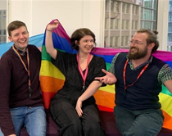
Who can apply?
You can apply if your organisation is a:
voluntary or community organisation
registered charity
constituted group or club
not-for-profit company or Community Interest Company
Who we can’t accept applications from:
Individuals or sole traders
Companies that can pay profits to directors, shareholders or members
Organisations based outside the UK
Organisations that don't have at least two trustees who aren't married / in a civil partnership / long-term relationship, living at the same address, or related by blood
one organisation applying on behalf of another
Notes:
Relevant to A4A and RC&P
We welcome applications from groups supporting communities:
- we haven’t been able to reach sufficiently previously and/or
- who traditionally have had poorer outcomes and/or
- who have/will be disproportionally impacted by the pandemic

Slide 17
Reaching Communities & Partnerships
How to apply
Your Proposal for Funding Form
We’ll ask you:
What your organisation does
What you'd like to do
Where your work will take place
How you’ll involve your community
How your work fits with local activities
Who will benefit & what difference you’ll make
How much money you need & what you’ll spend it on
How long you need the money for
Notes:
New questions on the online form:
Information about the number of staff and volunteers inc. lived experience of session management
Main & Senior contact details
We’ll be back in touch within 12 weeks either to let you know you’ve been unsuccessful or to ask for more information.

Slide 18
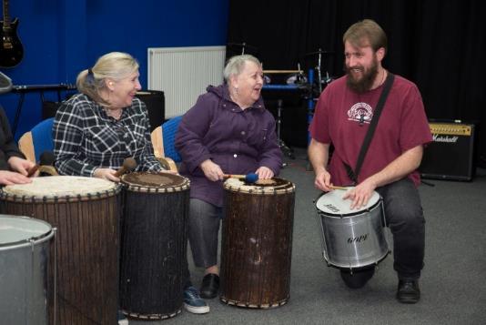
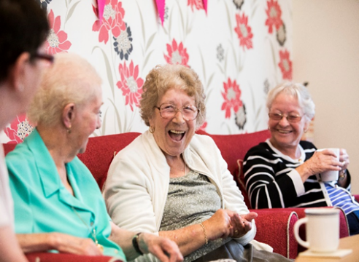
Reaching Communities & Partnerships
How to apply continued
If your application is eligible and fits well with our priorities, we’ll ask
for more information:
More detail about your proposal
Proposed budget
Overview of your financial position
Recent bank statement
Notes:
Develop your application at your own pace
Tell us about your proposal – in your own format
We will let you know if we need anything else
The information will depend on the complexity and scale of your proposal
We will send you a declaration after that clarification
We aim to let you know our decision within 12 weeks

Slide 19
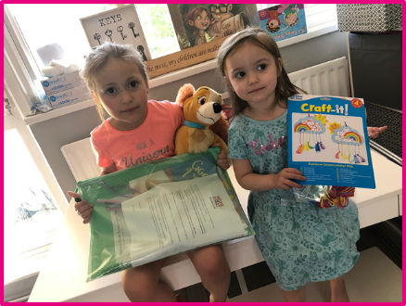
Safeguarding
If your proposal involves working with children, young people or vulnerable adults, you need to have a policy in place that explains how they'll be safe.
The NSPCC have lots of helpful advice about setting up and following good child safeguarding policies. NCVO also host a number of safeguarding resources.
If we do fund your organisation,
you must comply with our safeguarding policy.
Notes:
Taking into account different ways of working as a result of CV19, particularly online activities.
Ensure polices, practices and staff training are all up to date.

Slide 20
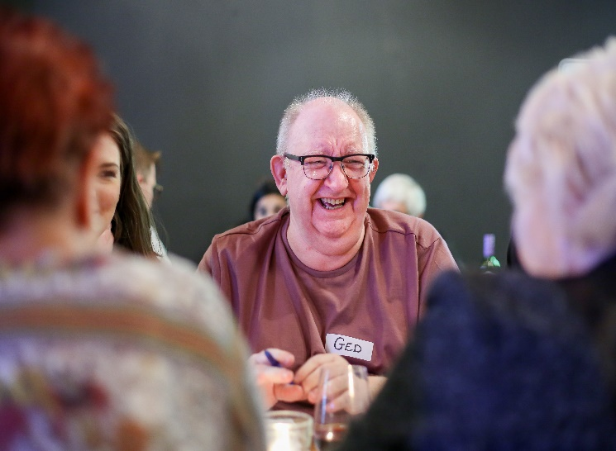
Reaching Community & Partnerships
If you’re successful
Grant set up
Return your offer letter within
one month
Start your grant within six months
End of year & grant reporting
How you’ve involved people from
your community
What difference the funding has made
What you’re learning
How you’re spending the money
https://www.tnlcommunityfund.org.uk/funding/managing-your-grant/over-10k
Notes:
Flexibility in grant management AKA Support & Learning
Conversational approach – be open & honest about progress

Slide 21
Questions

Slide 22
Find out More
Visit our website - www.tnlcommunityfund.org.uk
Call our Advice Line: 028 9568 0143
Email us at:
ADD TEAM INBOX@tnlcommunityfund.org.uk
Notes:
Also ask your CVS for support and if they can’t help they can signpost you to us.

