Slide 1



Better for Bolsover Conference
Kate Brown – Director of Joint Commissioning
& Community Development

Slide 2
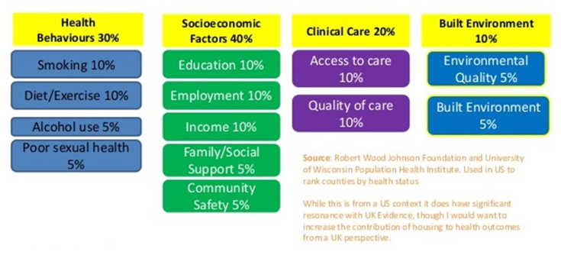
What makes and keeps us well?

Slide 3





Changes in health and care
We want to make collaboration and cooperation across different organisations an intrinsic part of how the health and care system delivers, and to do so in the best interests of the local area and its residents.
The new reforms are designed to:
Promote person-centred care. | Empower local health and care leaders and systems. | breakdown silos within and between health, social care, public health and the wider system. | Build on the system learnings from the pandemic and the response | Tackle the challenges faced in health and care.
New structures in place from July 2022 - Integrated Care Boards and Integrated Care Partnerships

Slide 4
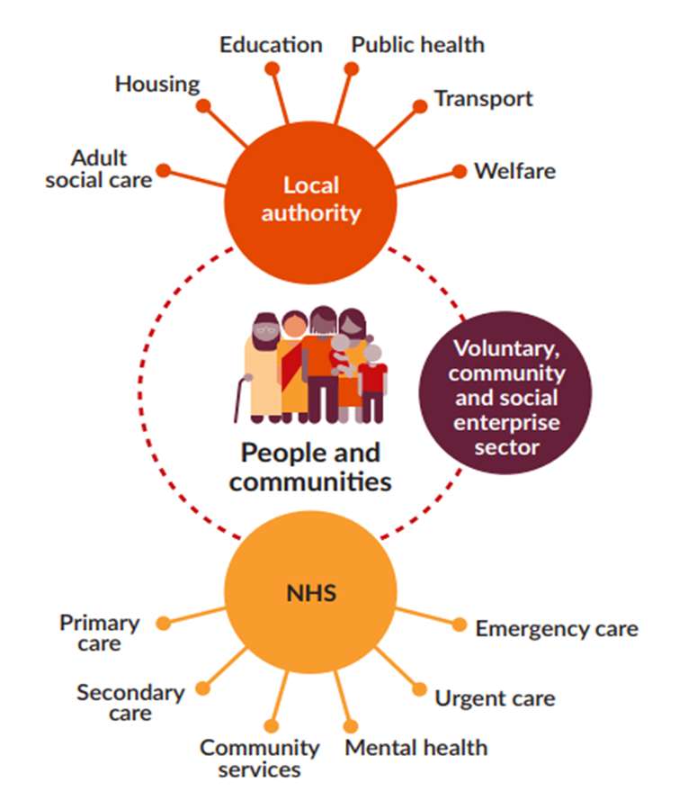
Integrating Care
Decisions taken closer to the communities they affect are likely to lead to better outcomes;
Collaboration between partners in a place across health, care services, public health, and voluntary sector can overcome competing objectives and separate funding flows to;
  help address health inequalities,
  improve outcomes, and
  deliver joined-up, efficient services for people
The changes aim to build on and strengthen existing integrated ways of improving peoples lives, to better plan and join up care.

Slide 5
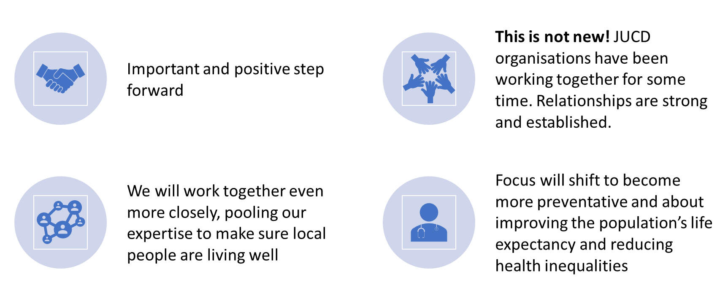
Joined Up Care Derbyshire
Health and care systems working together
In Derbyshire at all levels

Slide 6

Challenges & Opportunities

Slide 7
What does this mean for VCSE
National commitment to engaging and embedding the VCSE sector in system level governance and decision-making arrangements
Seen as a strategic partner in shaping, improving and delivering services and developing and delivering plans to tackle the wider determinants of health.
VCSE has a ‘place at the table’ to shape and influence, amplifying the voice of different communities and groups. We need to listen.
In Joined Up Care Derbyshire that means there is VCSE involvement in the partnership working that happens at all levels from local neighbourhoods to groups that work to benefit the population of Derby & Derbyshire.
Commissioners (within the NHS and Local Authorities) will be working more closely together.
Brings greater alignment from the statutory sector around the things that matter to people.

Slide 8
Thank you

